Slide 1
Haier - Internet of Food
A Healthy Food Solution Platform for the Smart Kitchen Scenario

Slide 2
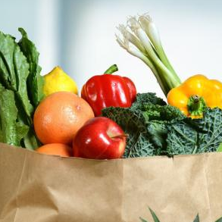
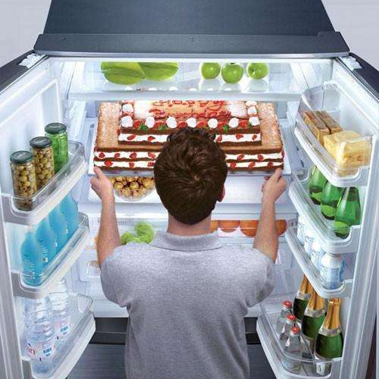
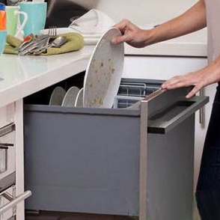
Scenario Product → Scenario
Internet of Food
One-stop Solution for the Kitchen Scenario
Eating
Buying
Storing
Cooking
Cleaning
Give you a piece of mind in the whole process.

Slide 3
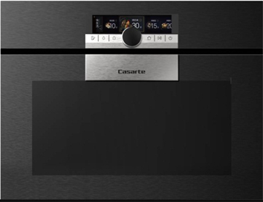
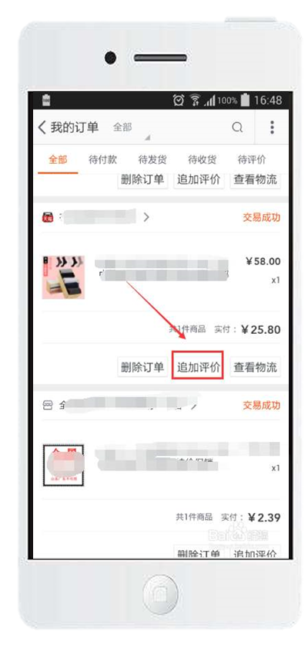
Ecosystem Industry → Ecosystem
Internet of Food disrupts
multiple industries
Networked Appliance
Ecosystem
Scenario
Integrates industrial resource service capability to create user value
Home Appliance Industry
Home
Furnishing
Industry
Cleaning
Eating
Food Industry
Logistics
Industry
……
and so on
Cooking
Buying
Healthcare Industry
Entertainment
Industry
Storing
Content
Industry
IoT Technology

Slide 4
Mechanism
Rendanheyi
Co-creation & Sharing
Experience EMC
Healthcare
Resources
Added-value Sharing
Win-win for all and evolving together
Household Services
User Touchpoint
Cooking Services
Integration of experience
User Touchpoint
Design
Services
Ecosystems of
application scenarios
Home Furnishing
Resources
Microenterprise
Home Appliance
Services
Solution EMC
Delivery and Installing
Integration
…
Microenterprise
…
Cleaning
Fresh Food
Purchase
Entertain-
ment
Recipe
Storage
IoT
Health

Slide 5
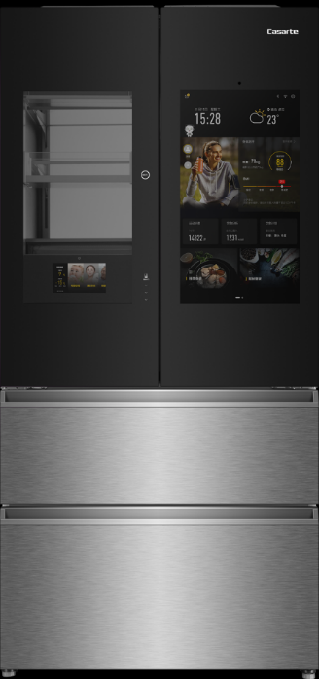
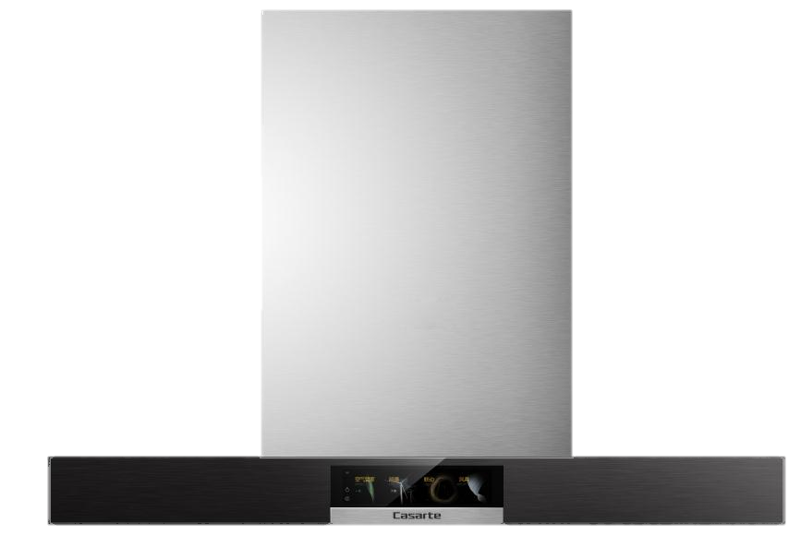
Iteration
Solution
Iteration on-demand
Ecosystem
Logistics-9
Kitchen Peripherals-10
Food -141
Smart
Healthcare
Resources Compete to Join
Networked
Appliance
Refrigerator
Smart Cooking
Resource Optimization
Scenario
IoT
Technology-15
Smart Fresh-keeping
AV Entertainment-15
Kitchen Appliance
Users
Smart Environment
Pre-set
Solution
Small Home
Appliance
Smart Cleaning
Drinks -92
Industry Media -6
Social Organizations-4
Ecosystem

Slide 6
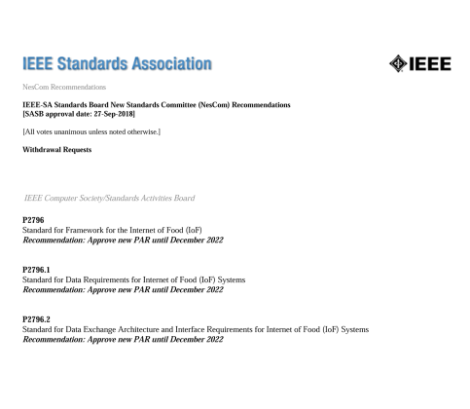
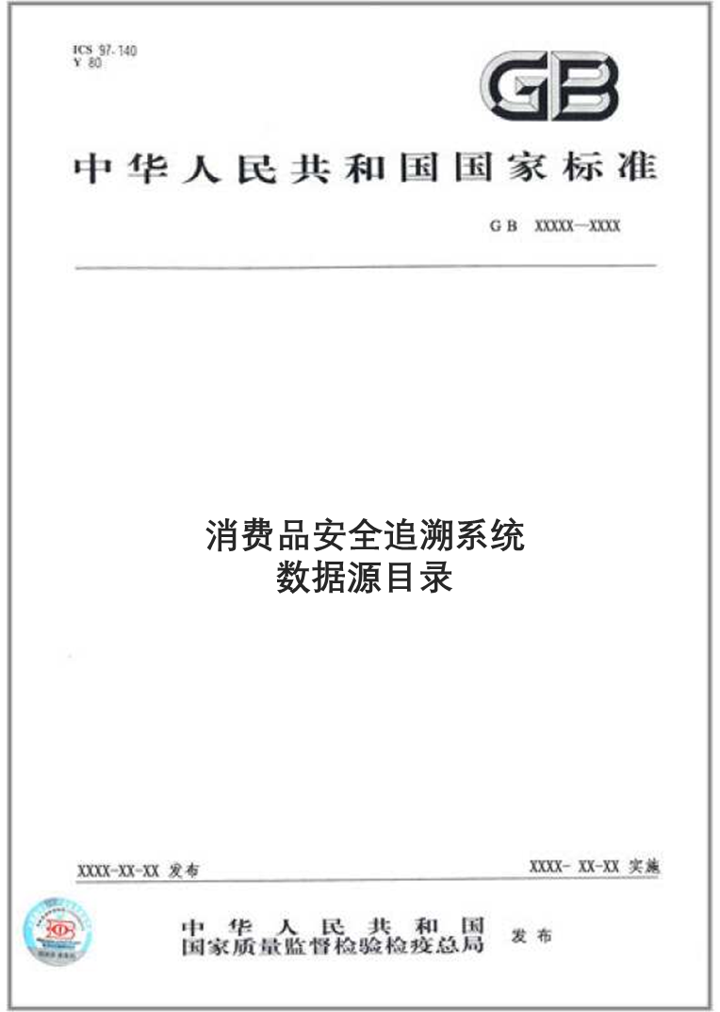
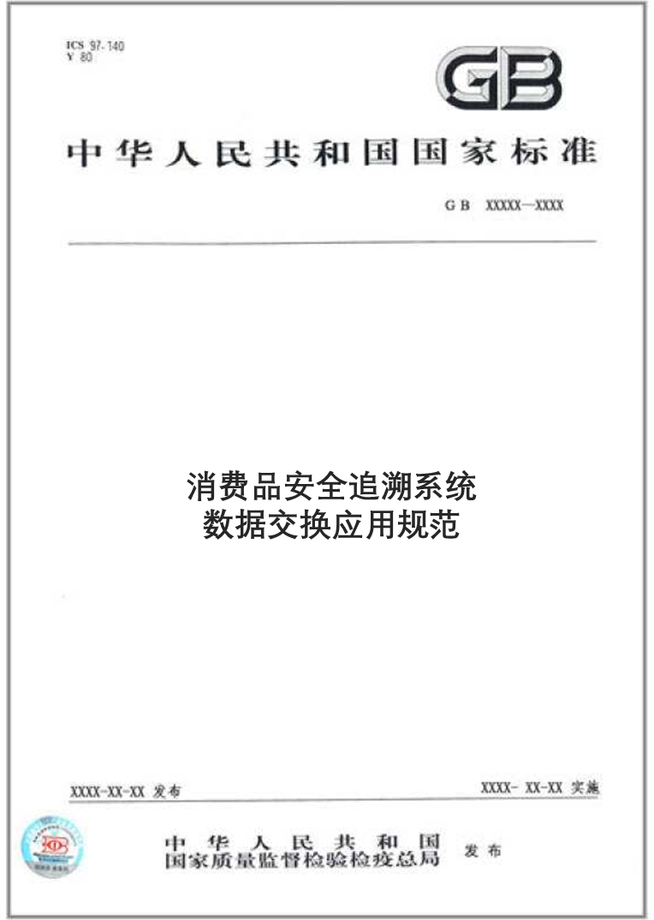
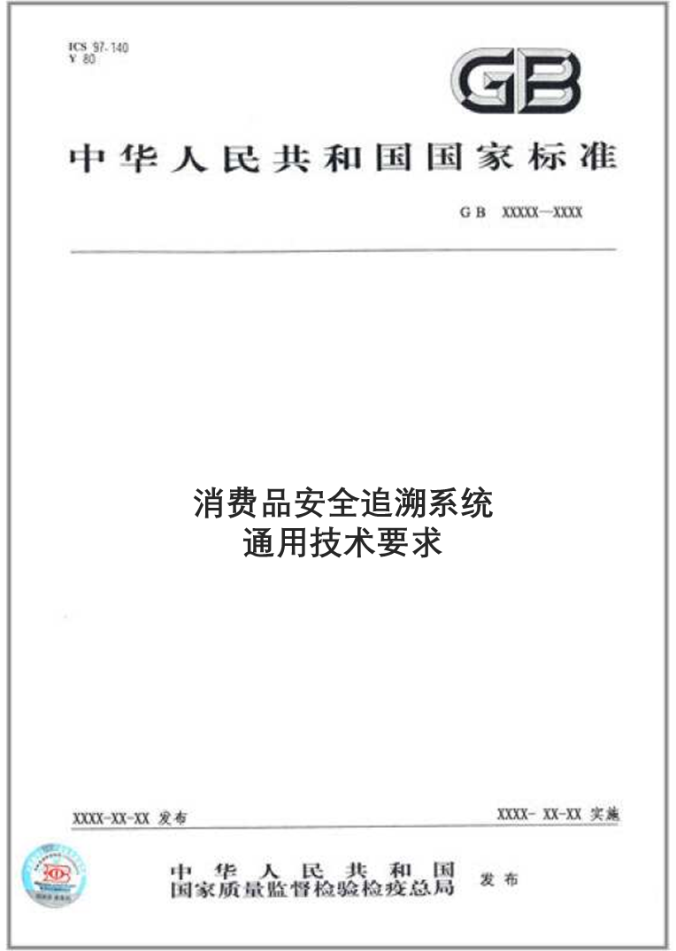
Recognition
Standard Setting
Multi-party Recognition
Standard Establishment
Industry Recognition
IEEE International Standards
China National Standards
China Federation of Logistics & Purchasing
Association Standard President Unit
Lead the establishment of IoF ecosystem alliance -
9 major industries and
207 premium resources

Slide 7
Thanks

