Slide 1
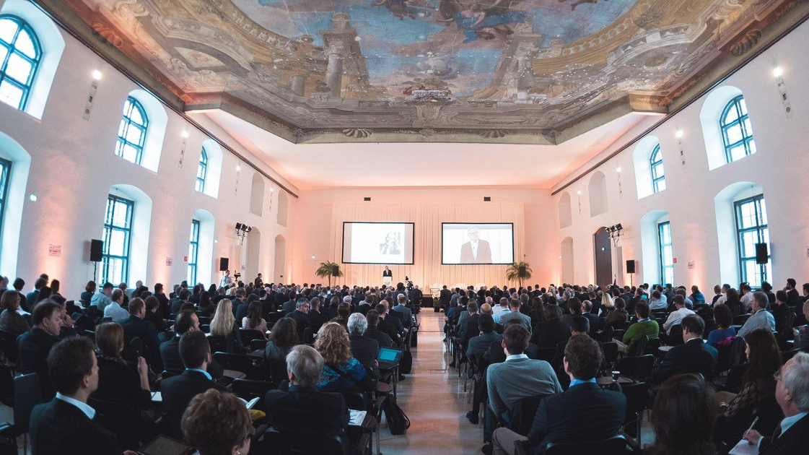

Slide 2
BUILDING
INNOVATION
SUPERCLUSTERS
Building trust-based collaboration platforms for growth industries
#GPDF19
11th Global Peter Drucker Forum

Slide 3
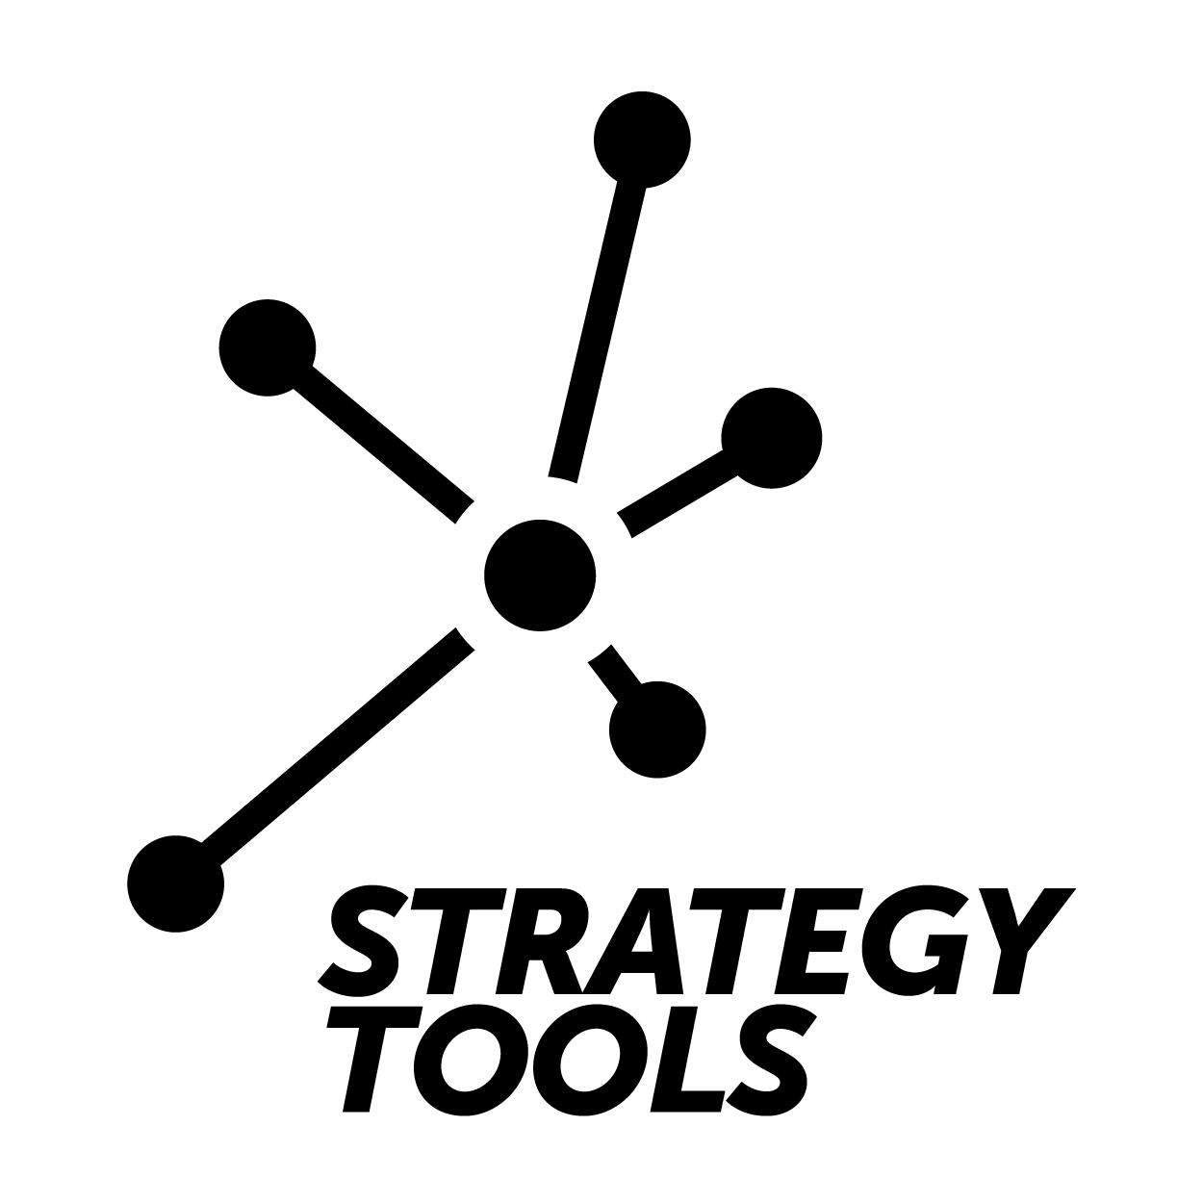
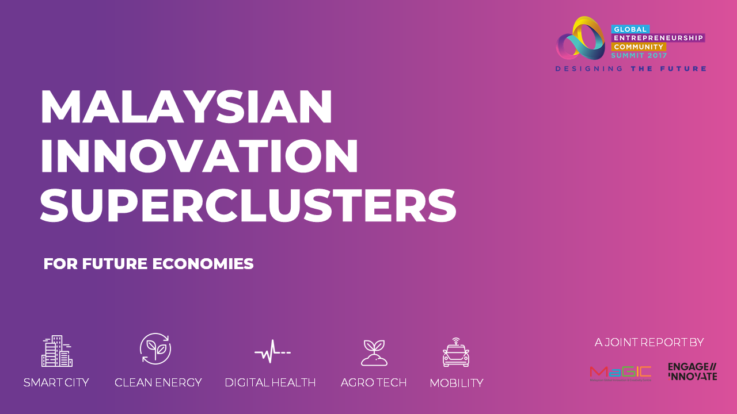
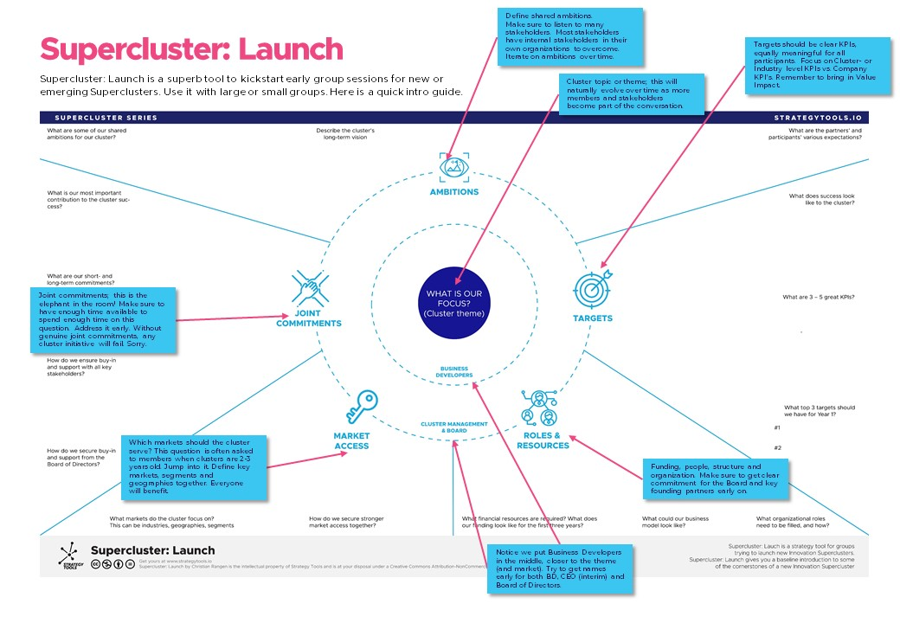
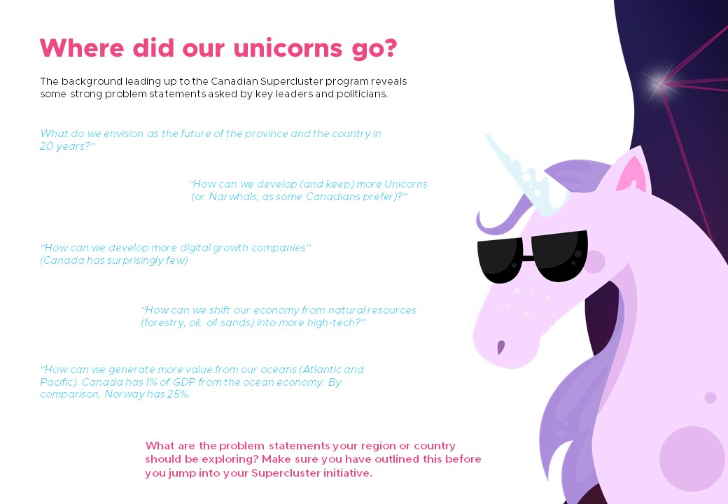
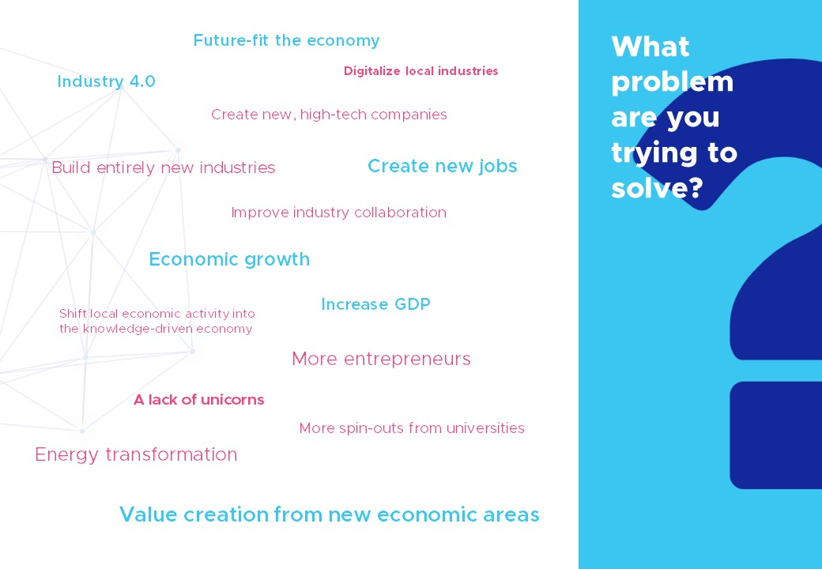
OUR REPORTS
https://www.engage-innovate.com/reports

Slide 5
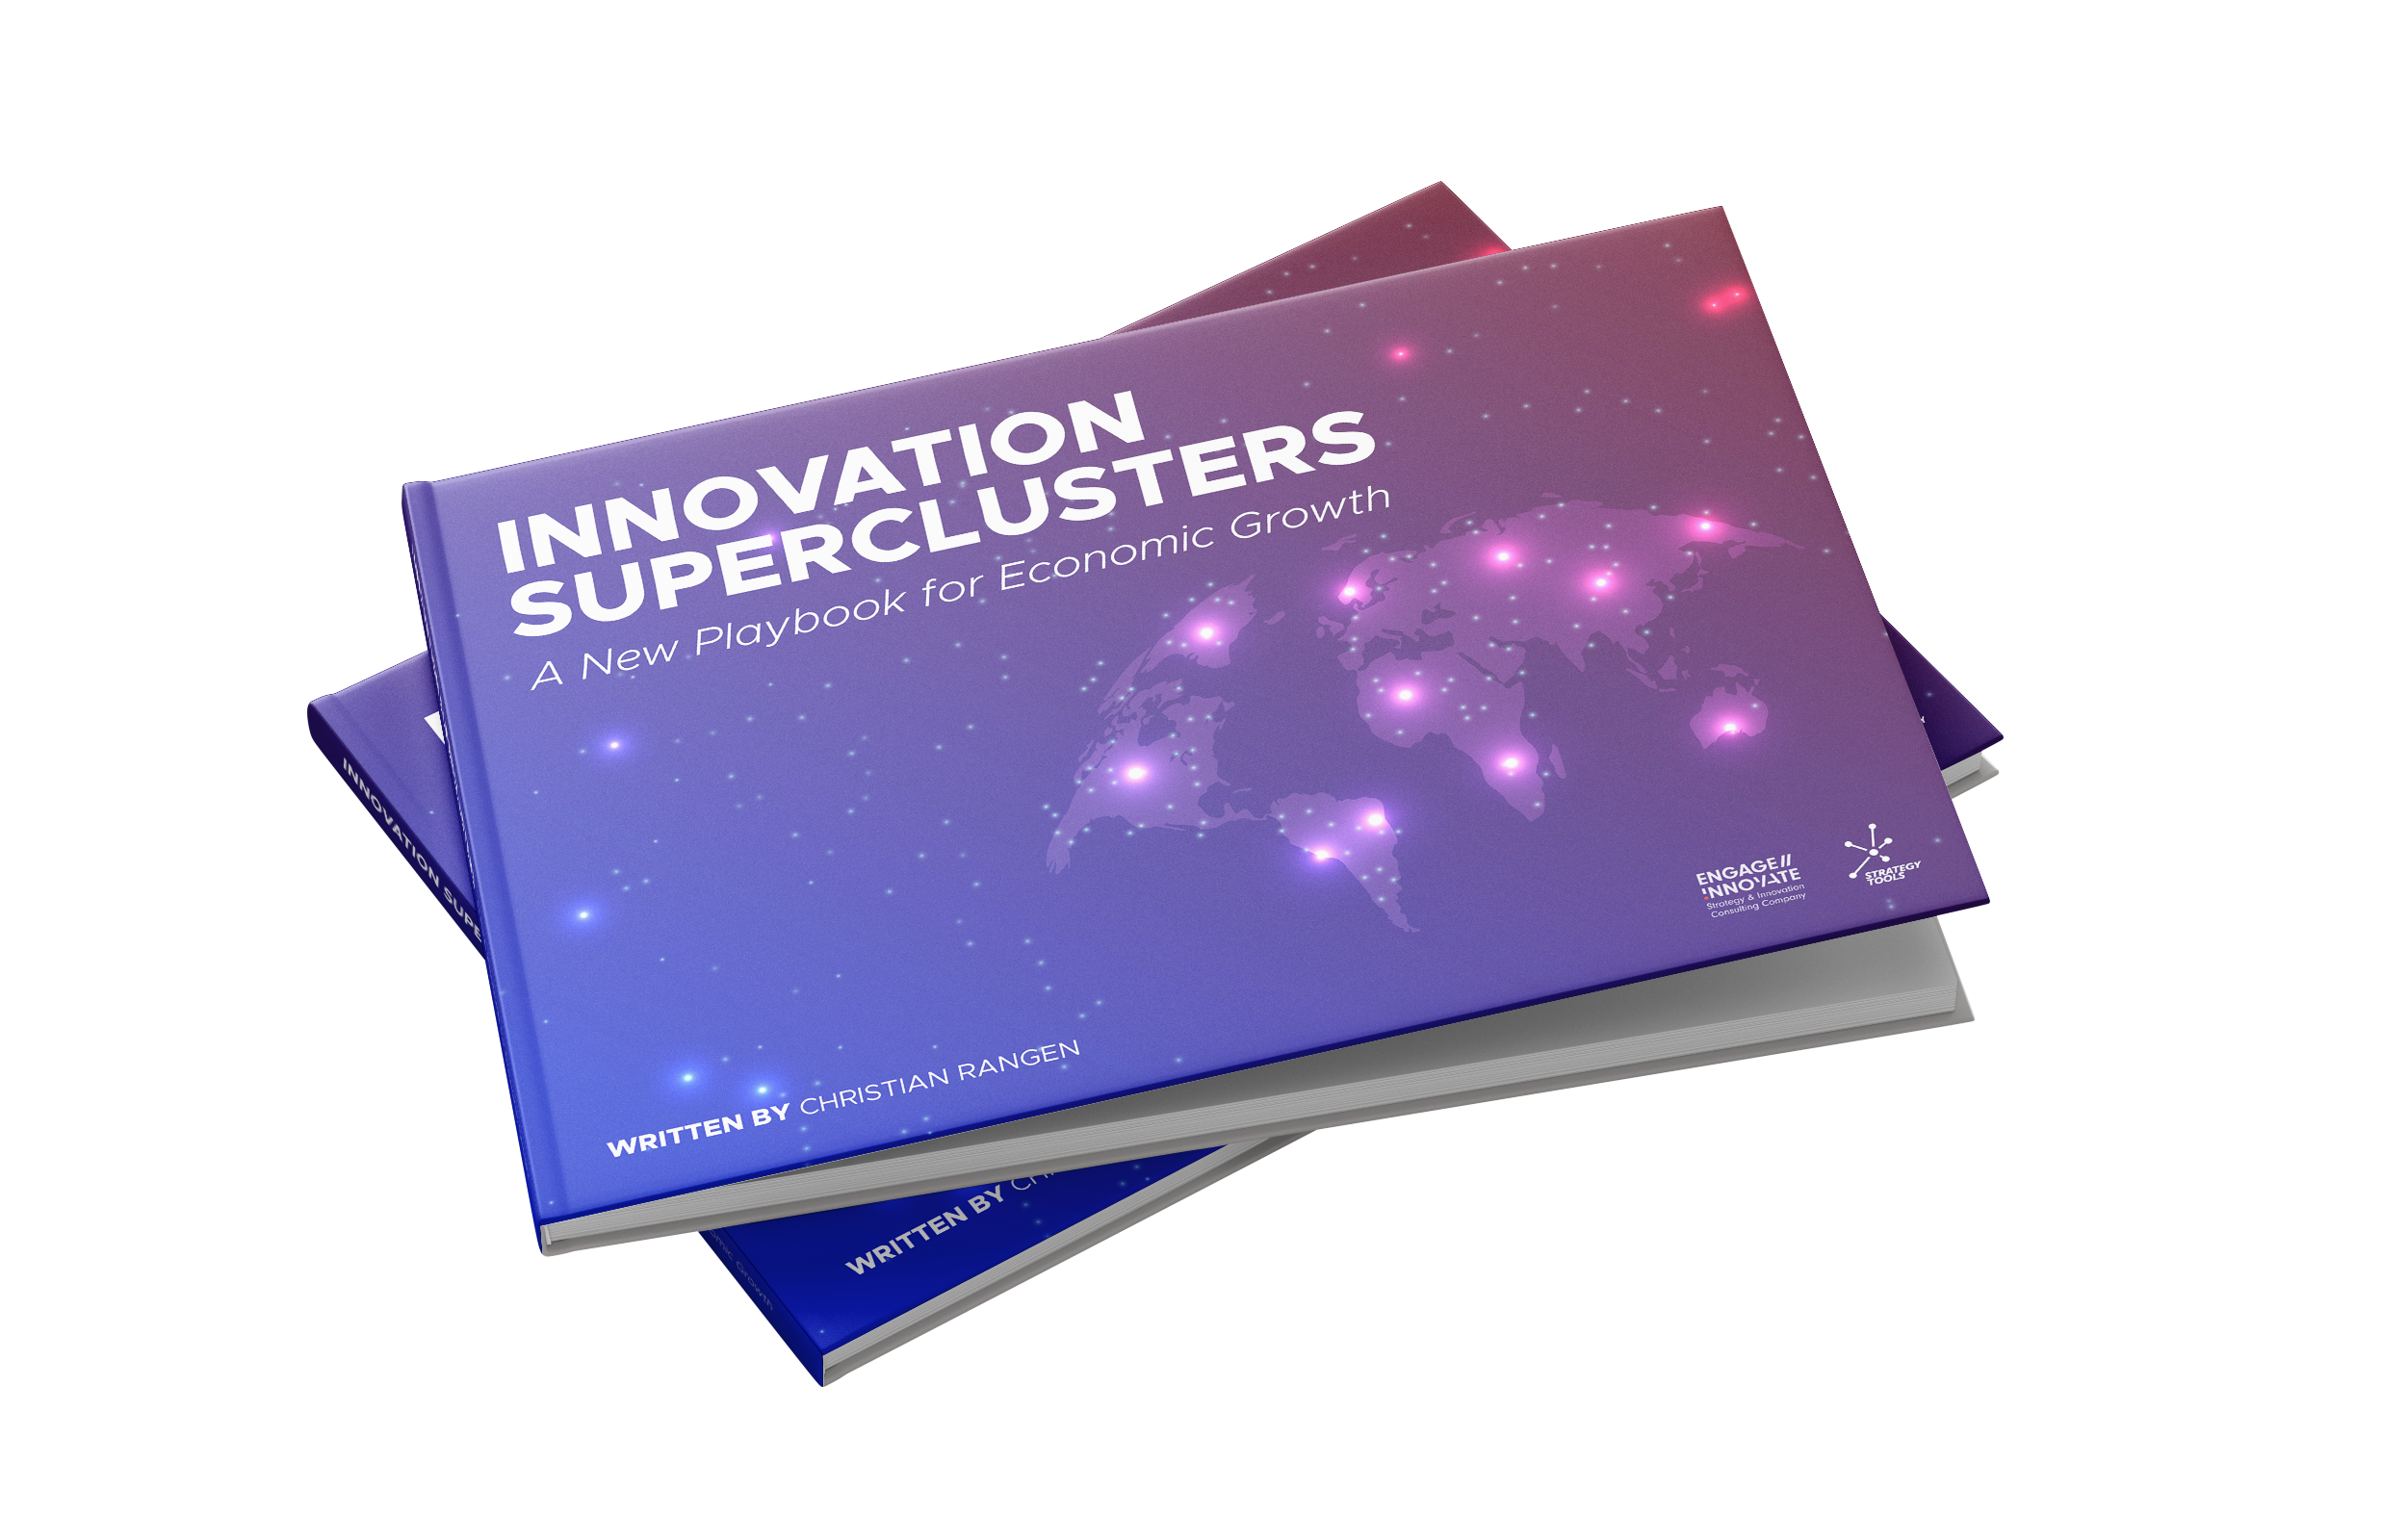
INNOVATION SUPERCLUSTERS A New Playbook for Economic Growth
Coming 2020

Slide 6
THREE KEY FINDINGS
SUPERCLUSTERS ON THE RISE GLOBALLY
FACING A CLUSTER PARADIGM SHIFT
VISIONARY GOVERNMENTS REQUIRED
#Supercluster

Slide 8
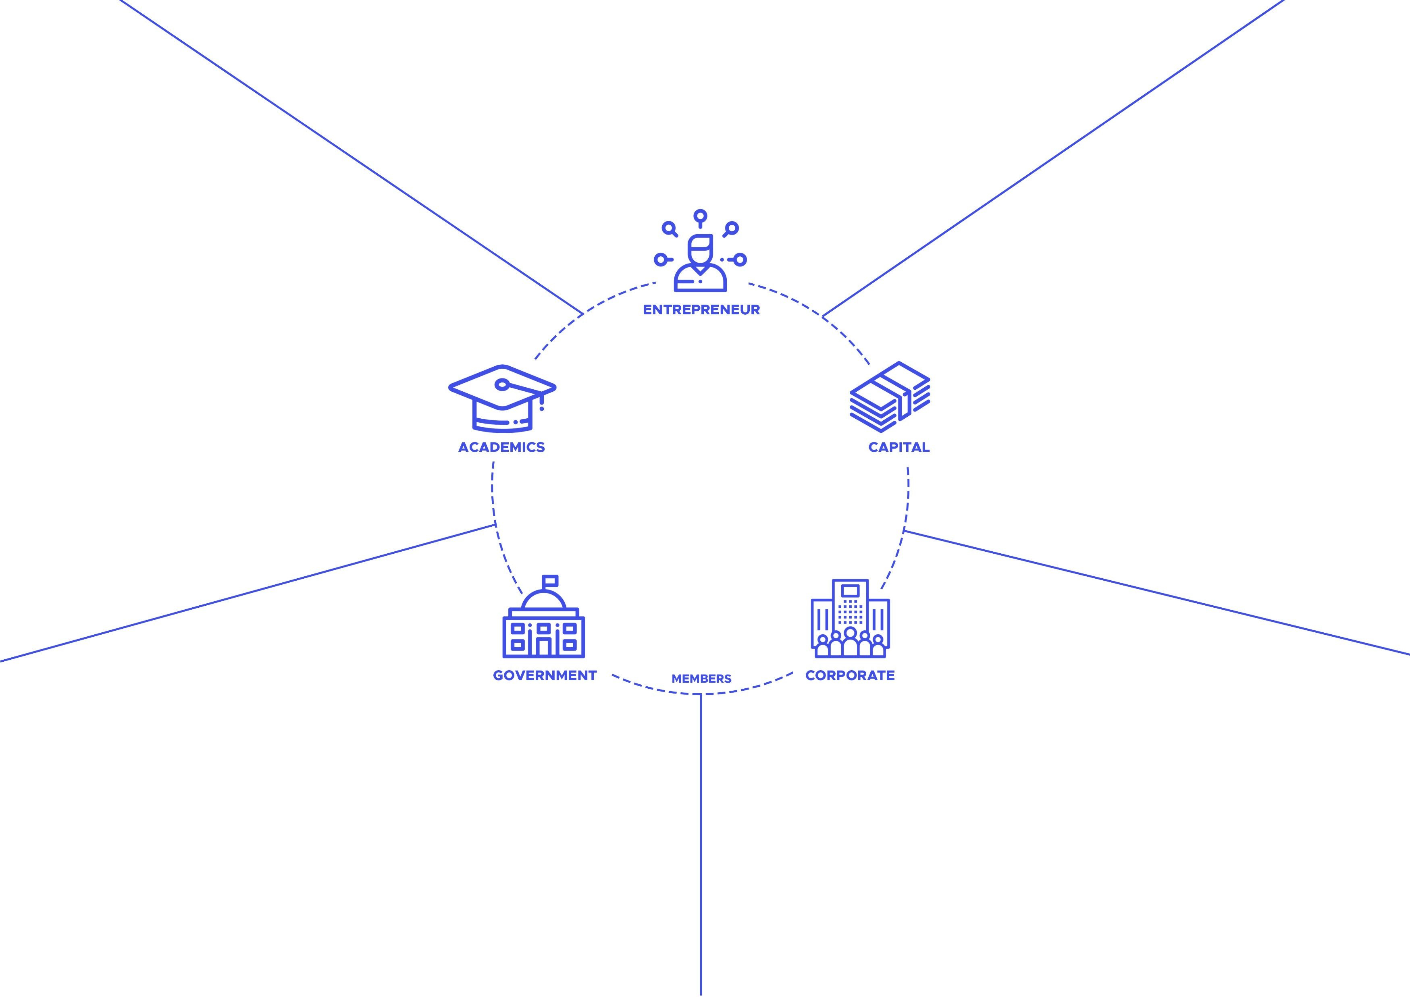

Slide 17
Innovation Superclusters are…
Engines of economic growth, by connecting 100’s of members and partners
Collaboration networks built around the industries of the future
Private-public partnerships, developed by design
Trust-based collaboration platforms
Solving Industry level challenges & opportunities
Magnets that attract talent, capital, researchers and companies

Slide 18
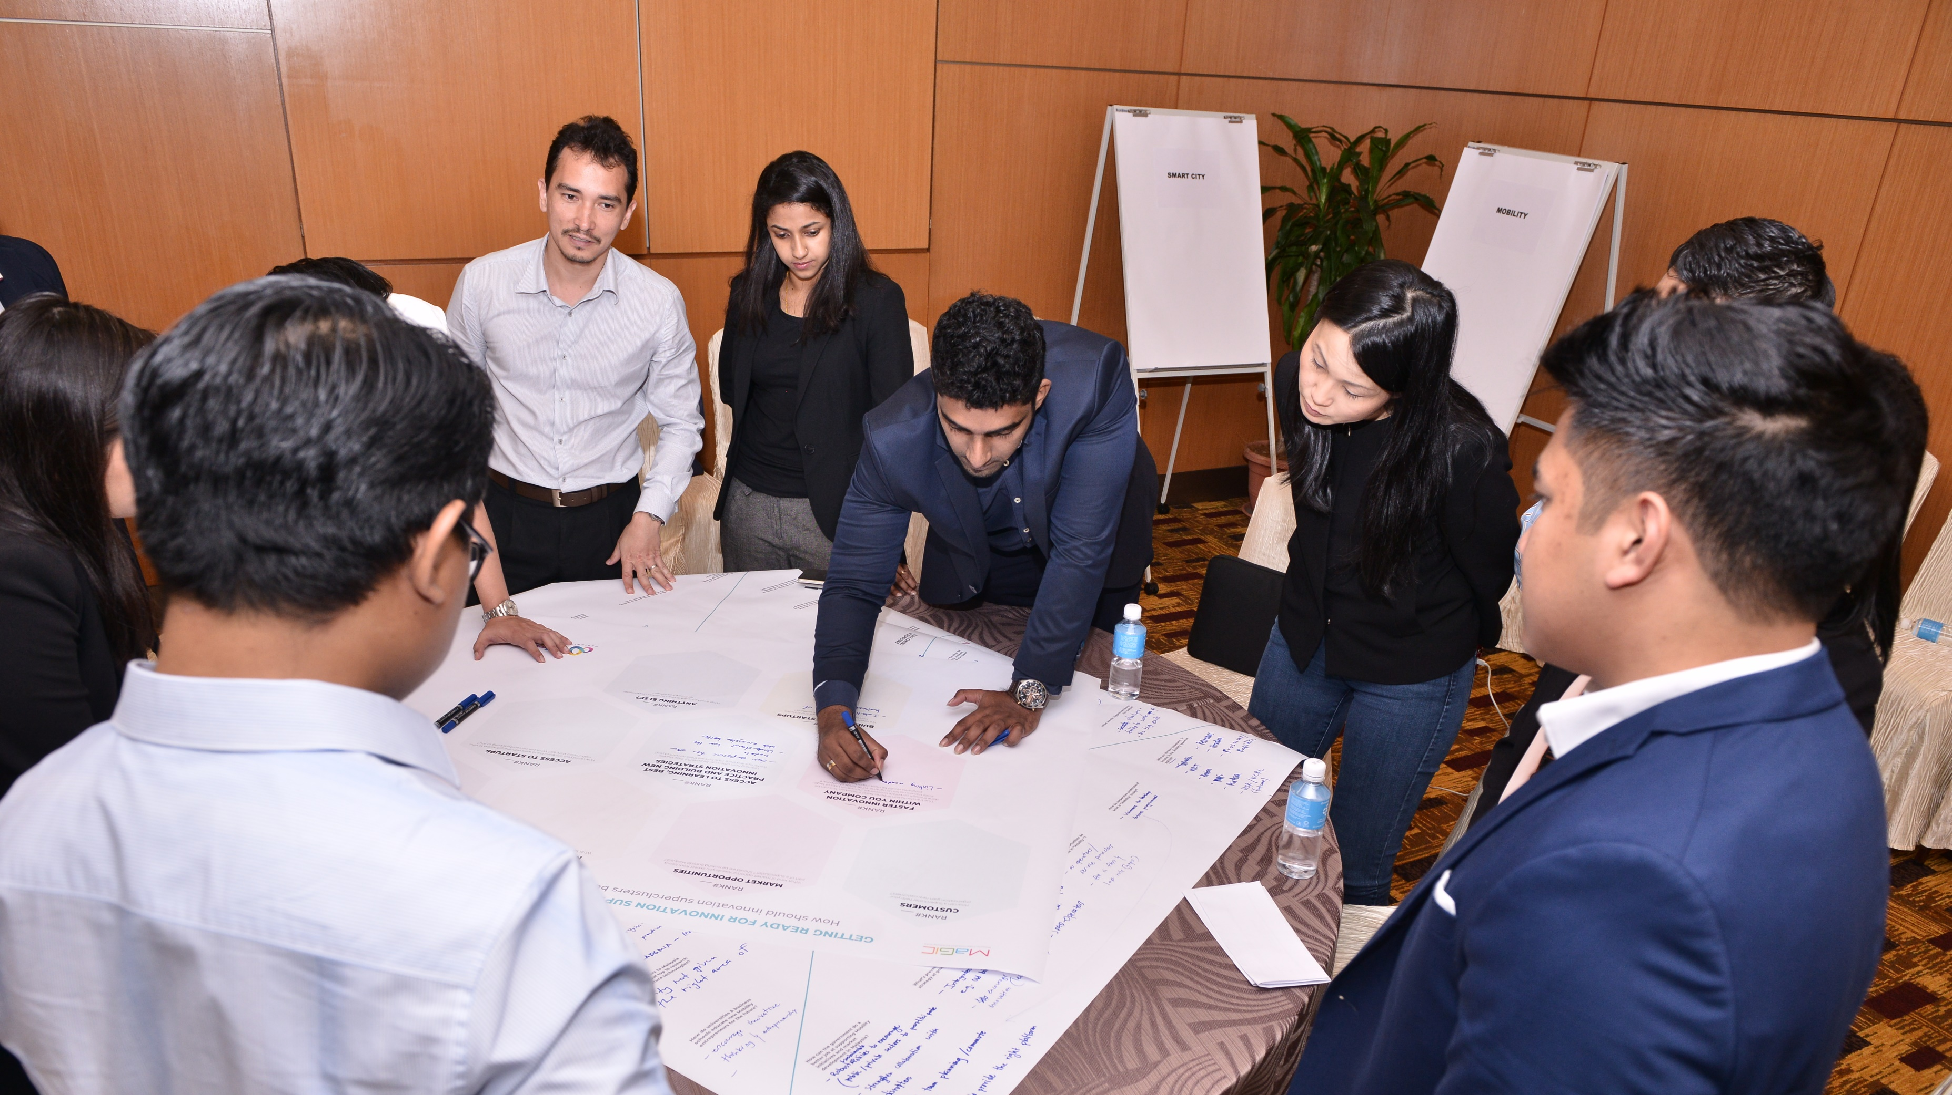

Slide 19
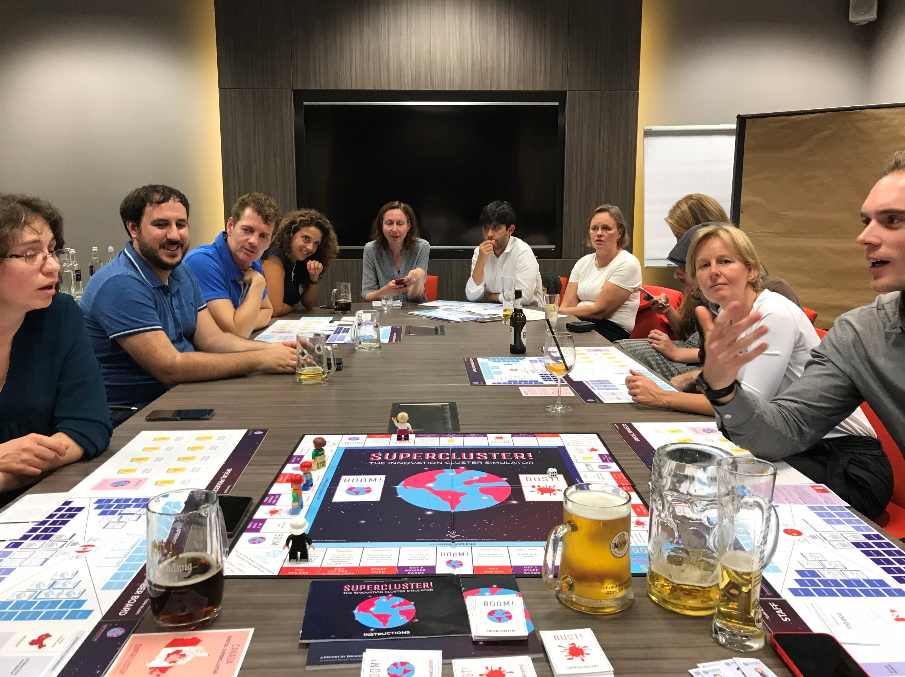

Slide 20
Superclusters
vs.
Ecosystems
Innovation Superclusters vs. Innovation Ecosystems, how are they different?
Specific theme
No specific theme
Clear organization, legal entity
No specific organization, no single entity
CEO, Management team
No specific management team
Actively recruiting, supporting and developing around one theme
Multiple themes, industries and domains overlap
Specific funding, usually government and industry collaboration
Multiple themes, industries and domains overlap
Counting members, partners
Usually not able to count members across a wide ecosystem
Annual report and frequent communications
No official reports and communications
Actively built, nurtured and led over 3,5,10+ years
Emergent, supported by policies and communities, but often naturally evolving

Slide 23
THREE STEPS FOR SUCCESFUL SUPERCLUSTER INITATIVES

Slide 24
BUILD AROUND THE INDUSTRIES OF THE FUTURE

Slide 25
DEFINE CLEAR PROBLEM STATEMENTS

Slide 26
INVEST IN STRATEGY, POLICY AND CAPABILITIES

Slide 27
INDIAN INNOVATION SUPERCLUSTER INITIATIVE

Slide 28
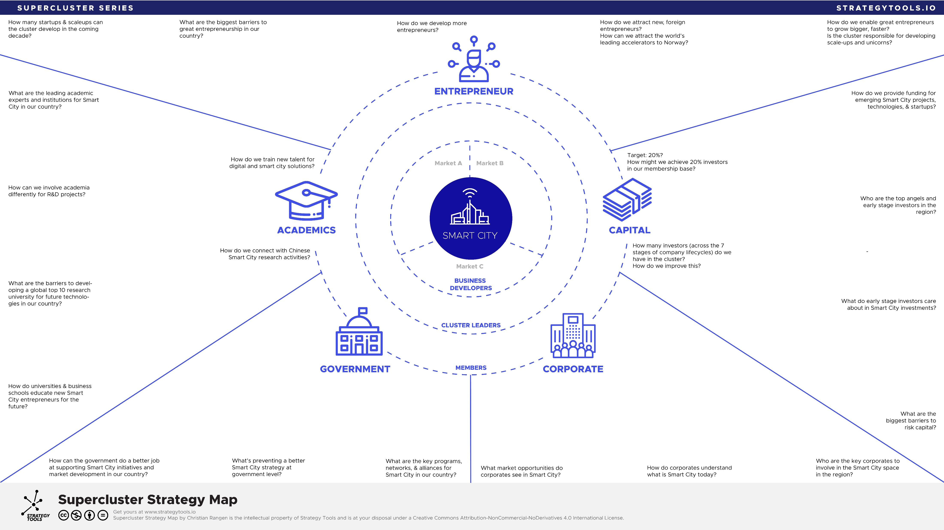
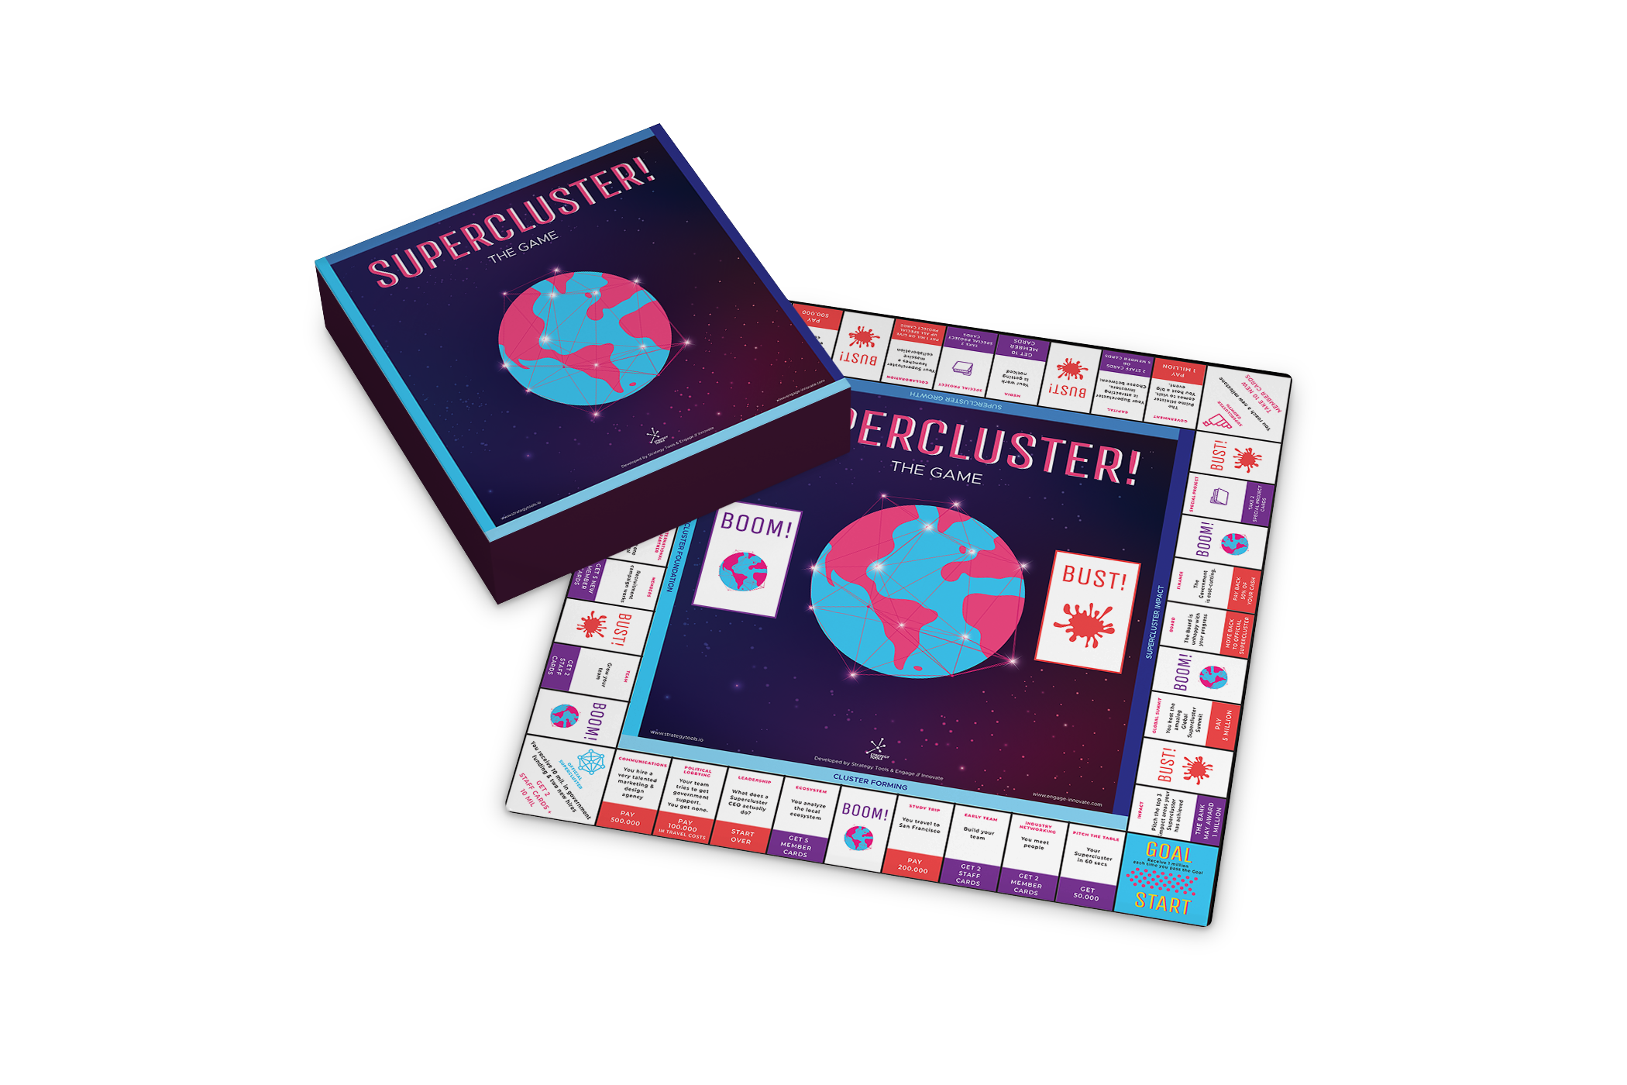
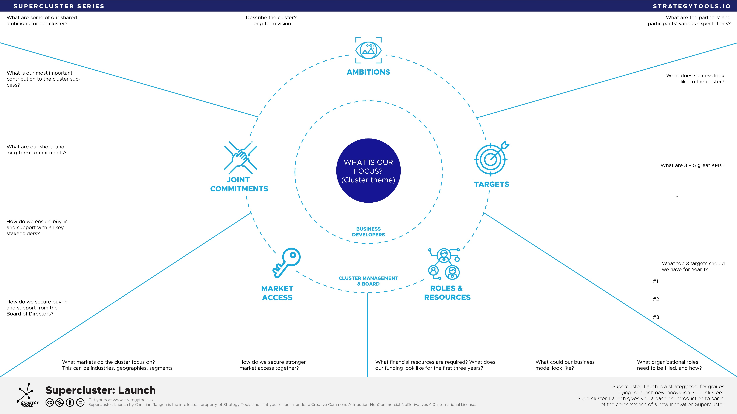
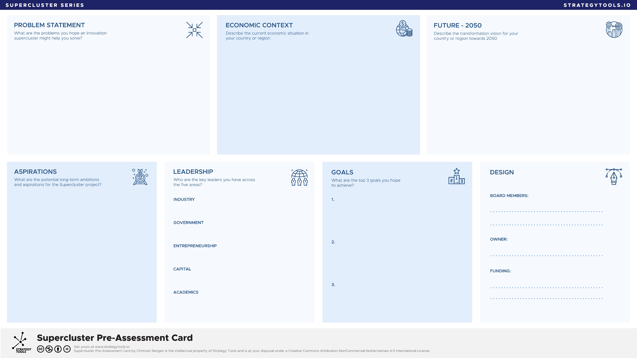
The
Supercluster
Toolkit
#Supercluster

Slide 29
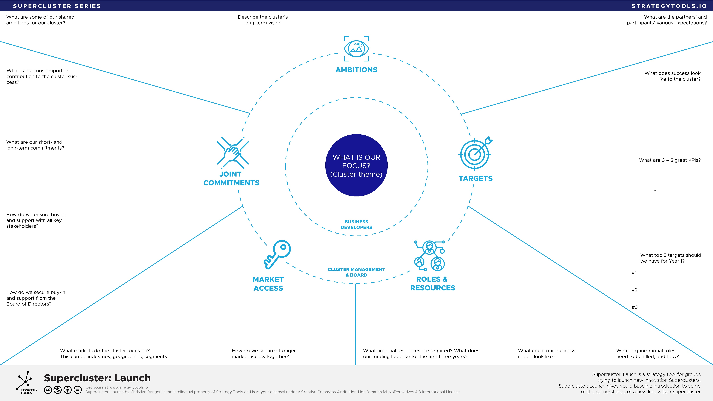
Supercluster: Launch
Define shared ambitions. Make sure to listen to many stakeholders. Most stakeholders have internal stakeholders in their own organizations to overcome. Iterate on ambitions over time.
Targets should be clear KPIs, equally meaningful for all participants. Focus on Cluster- or Industry level KPIs vs. Company KPI’s. Remember to bring in Value Impact.
Supercluster: Launch is a superb tool to kickstart early group sessions for new or emerging Superclusters. Use it with large or small groups. Here is a quick intro guide.
Cluster topic or theme; this will naturally evolve over time as more members and stakeholders become part of the conversation.
Joint commitments; this is the elephant in the room! Make sure to have enough time available to spend enough time on this question. Address it early. Without genuine joint commitments, any cluster initiative will fail. Sorry.
Which markets should the cluster serve? This question is often asked to members when clusters are 2-3 years old. Jump into it. Define key markets, segments and geographies together. Everyone will benefit.
Funding, people, structure and organization. Make sure to get clear commitment for the Board and key founding partners early on.
Notice we put Business Developers in the middle, closer to the theme (and market). Try to get names early for both BD, CEO (interim) and Board of Directors.

Slide 30
Supercluster Strategy Map
Here’s a quick example of an early outline for a Smart City Supercluster located in Norway. Each tool can easily be adapted to the specific Supercluster theme it is addressing. The Supercluster Strategy Map can be used individually, by the management teams or in any large-scale group session with partners and members. We have used this in groups of 2 – 150 people at once, often with 10 – 15 tables and Maps in the same room.
Start with your Supercluster theme, for example adventure travel tech or clean energy.
Identify the top market segments your cluster should focus on (this can be tough if you have too strong a research agenda)
List your business developers
(they need to go hand-in-hand with your market segments)
Map out your cluster management team and board of directors
Moving outwards, map out the key members or partners you have in each of the five pillars.
Finally, invite all your key stakeholders into the dialogue, working on the 23+ questions listed around the Supercluster Strategy Map

Slide 31
CONCLUSION
SUPERCLUSTERS ON THE RISE GLOBALLY
FACING A CLUSTER PARADIGM SHIFT
VISIONARY GOVERNMENTS REQUIRED

Slide 32
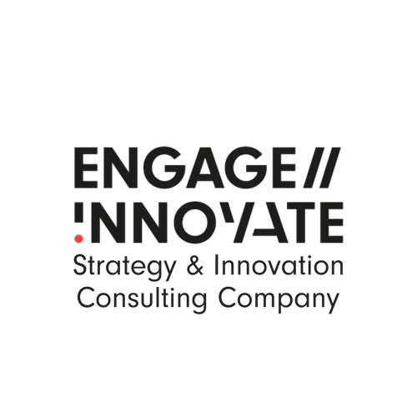
Global strategy & innovation consulting company. Advising and supporting governments and Innovation Clusters globally.
Extensive experience with cluster programs from the Nordics, Europe and Asia.
Global strategy platform.
Free access to innovation cluster strategy tools, software apps and training programs.
Developer of Supercluster! the innovation cluster simulator.
Media requests:
Jolene@engage-innovate.com
Supercluster Simulation, Tools & Training:
Adelina@strategytools.io
Speaking & consulting requests:
Hello@engage-innovate.com
Download free Supercluster Strategy Tools
www.strategytools.io
www.engage-innovate.com
www.strategytools.io

Slide 33
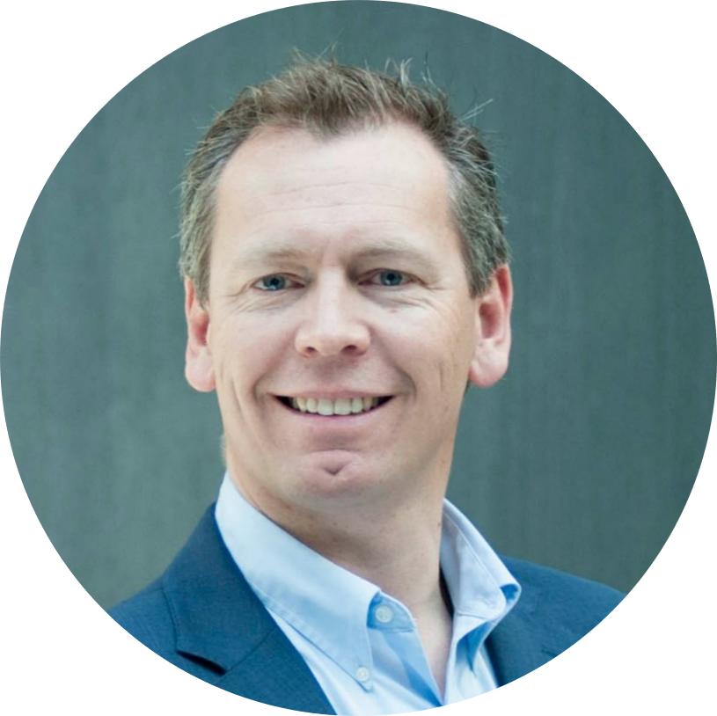
Christian Rangen
Christian Rangen is a strategy & transformation advisor to companies, innovation clusters and governments around the world. He is a transformation advisor to companies, CEO and ecosystems and works closely with governments to accelerate national transformation.
Christian Rangen is founder of Engage // Innovate – a global strategy & innovation consulting company and Strategy Tools – the Modern Strategist’s Platform.
Over the past 10+ years he has worked with a global clientbase to support transformational strategies across energy, mobility, tech, software, utility and consulting. His programs range from one day executive workshop, 18 months strategy journeys up to multi-year engagements, working most closely with the CEO, Chairman of the Board or Chief Strategy Officer.
He is the inventor of over 50 visual strategy tools in use with 1000’s of companies and clusters around the world. Built around his research since 2010, Strategy Tools is a global open-source strategy platform, with more than 50 visual strategy tools, spanning strategy, innovation entrepreneurship, business model portfolios and Superclusters. Working with a global team of strategy leaders and software developers, Strategy Tools is quickly turning into a go-to-hub for strategist’s worldwide. Recently, the team launched three strategy simulations, currently being deployed with leading companies and business schools around the world.
He is also faculty at BI – Norwegian Business School, where he has been teaching strategy, entrepreneurship and numerous executive education programs.
His recent publications include the Shifting Energy Arena (2018), Building Innovation Superclusters (2019) and Building The Transformational Company (2020)
Christian@engage-innovate.com
+47 924 15 949

Slide 34
BUILDING
INNOVATION SUPERCLUSTERS
www.engage-innovate.com www.strategytools.io
#Supercluster

