Slide 2
Valuation Ascent in last 4½ Years
19x to 25x Value Expansion
Quanterix Valuation ($m)
Represents 12X on a per share basis inclusive of 3.2 share split
Our current Follow-On offering pricing represents 19x Value expansion vs. YE2014
At 2019 high of $36.15, this represents 25x Value expansion vs. YE2014
This far exceeds market and even some of the best regarded assets in our industry/market:
25x
Represents 8X on a per share basis inclusive of 3.2 share split
19x
 | 1.7x
 | 5.7x
 | 4.5x
 | 19x-25x
YE 2014
YE 2015
YE 2016
YE 2017 (IPO)
YE 2018
2019 May ATM
2019 Aug.
2019 HIGH
Follow-on
Share Price
0.97* | 1.42** | 2.54** | 15.00 | 18.31 | 22.72 | 25.25 | 36.15
* Globalview Advisors LLC 409A Valuation Reports, price prior to 3.2 reverse split
** Orchard Partners 409A Valuation Reports, price prior to 3.2 reverse split

Slide 3
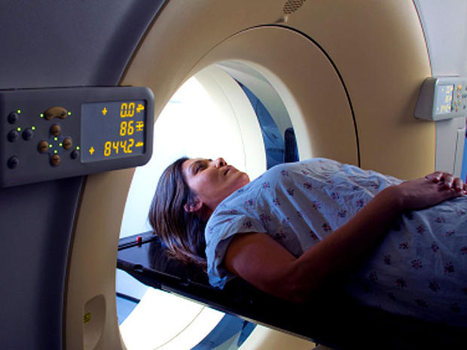
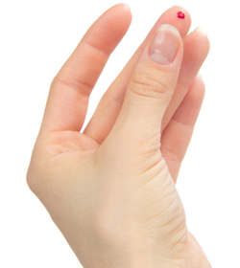
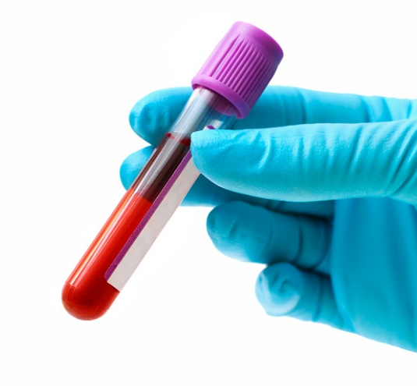
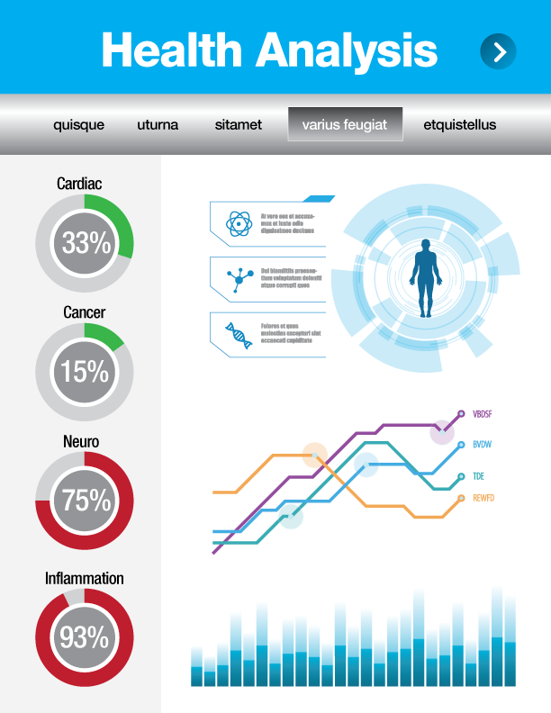
Convergence of Technology and Healthcare
Digital Biomarkers Revolution
Invasive
analog
digital
digital biomarkers
Non-Invasive

Slide 4
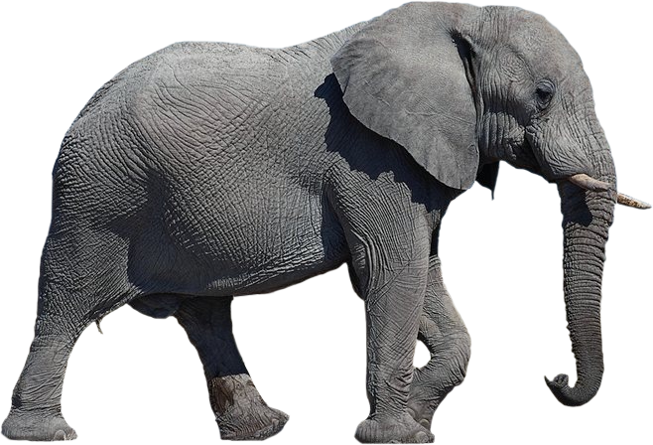
Di5 Model
1
Greater Purpose – Incite a Revolution
FIVE STEPS TO COMMERCIALIZING DISRUPTIVE INNOVATION
2
360° Immersion - Ecosystem
3
Greatness through People, Culture & Leadership
4
Strategic Roadmap
5
Superb Execution - High Impact Speed Leading

Slide 5
