Slide 1
KEEP IT SMALL, KEEP IT SIMPLE
Jos de Blok
transforming neighborhood care - Buurtzorg Overview
Notes:
Titel
subtitel
Spreker

Slide 2
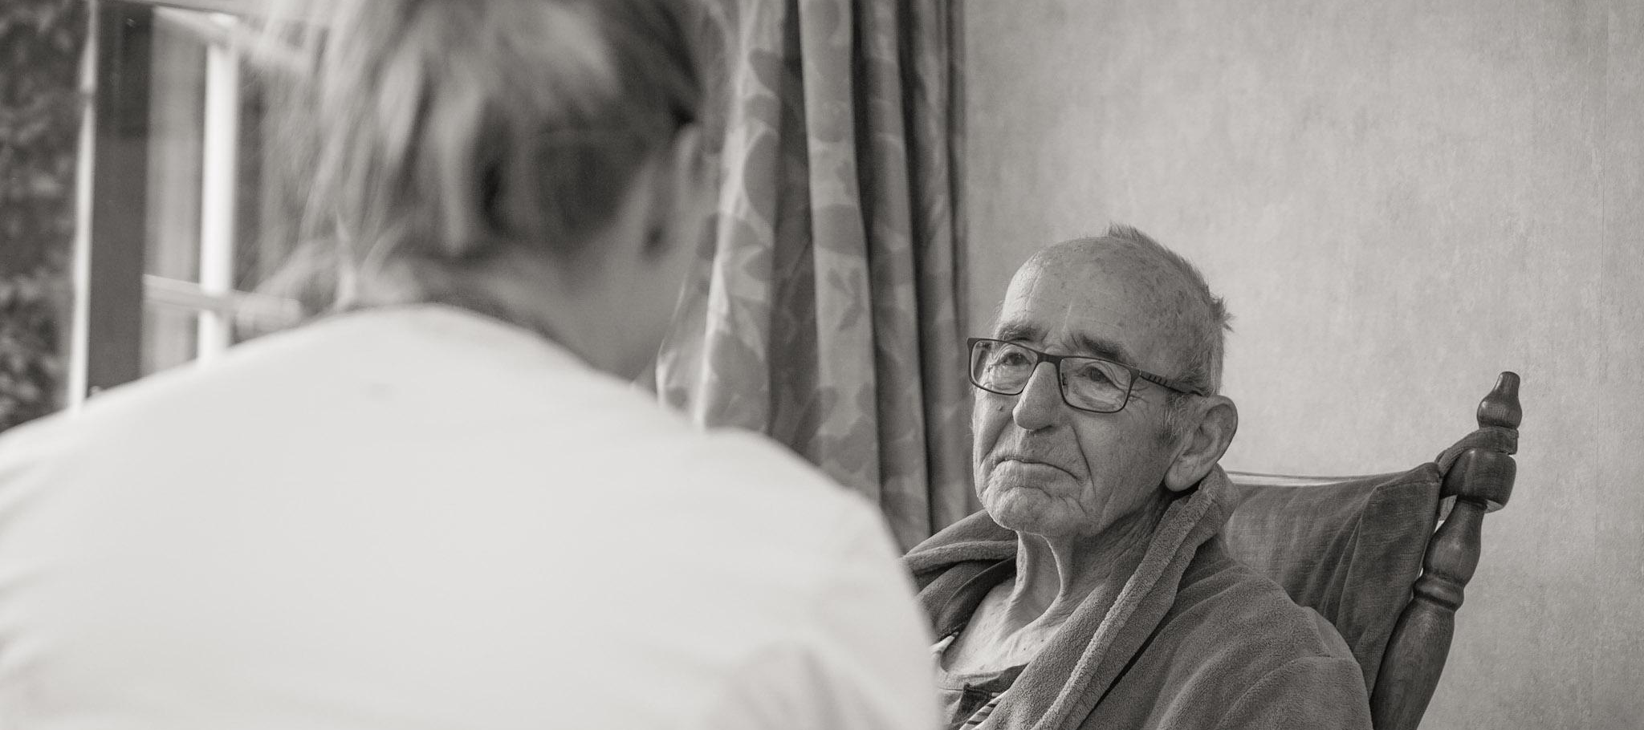
BUURTZORG QUICKSCAN
social healthcare
focus on relationships
solutions instead of indications
separated care and back office processes
buurtzorgweb- and square, knowledge, information, communication
scale of the neighborhood
© 2019 Buurtzorg International Holding BV - All Rights Reserved

Slide 3
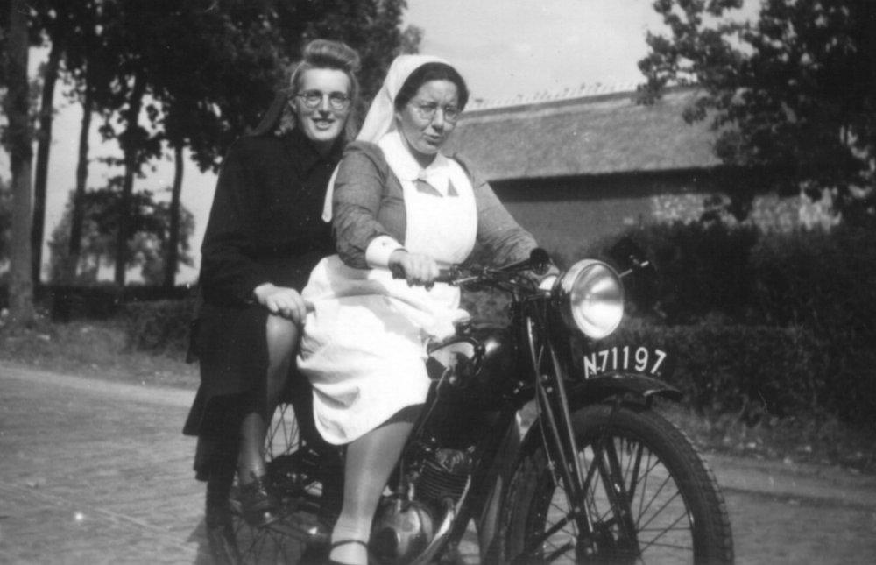
START 2007
Starting an organization and care delivery model for community care with:
independent teams up to 12 nurses
Working in a neighborhood of 5.000-10.000 people
Teams responsible for the organization and the complete process

Slide 4
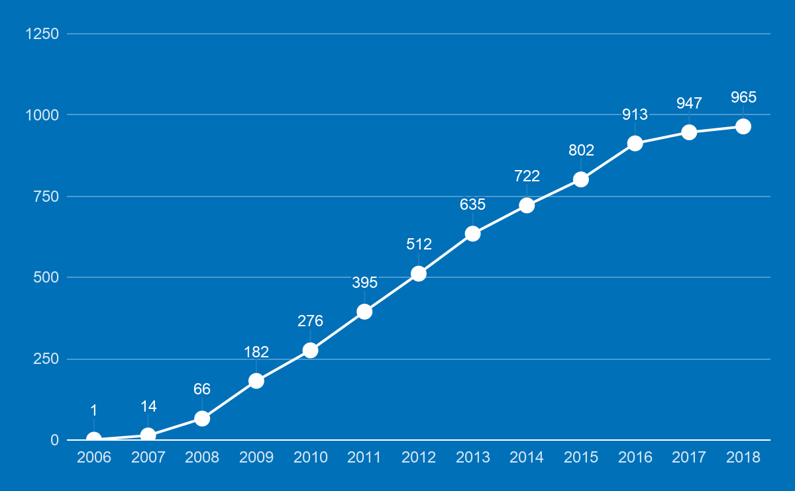
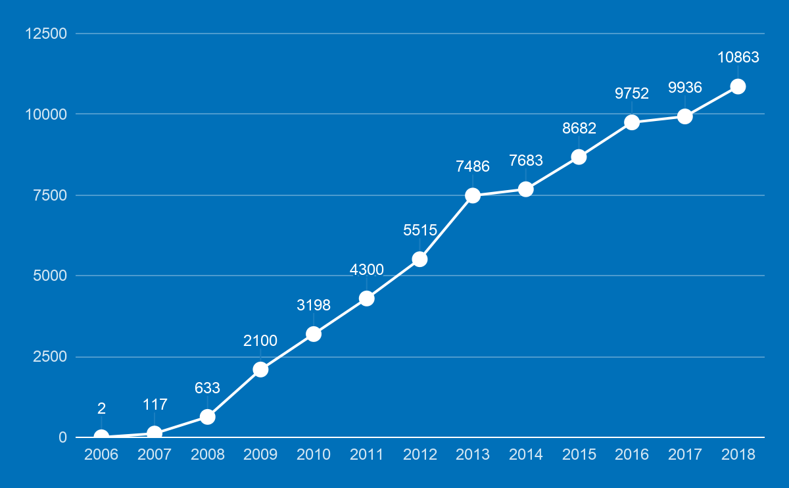
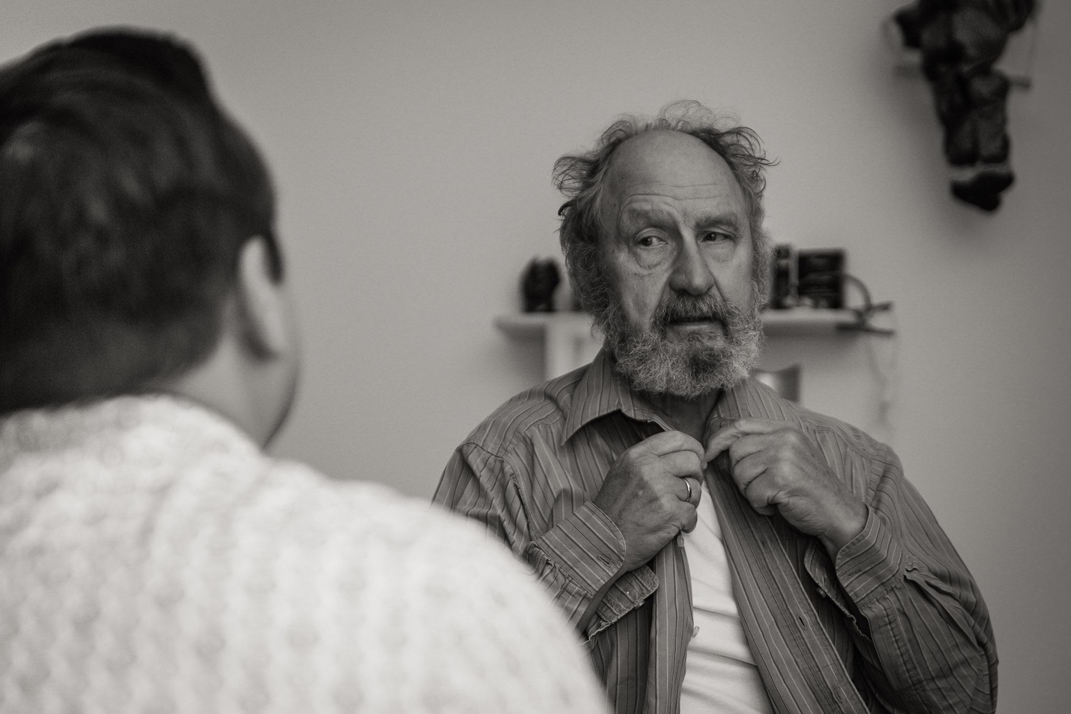
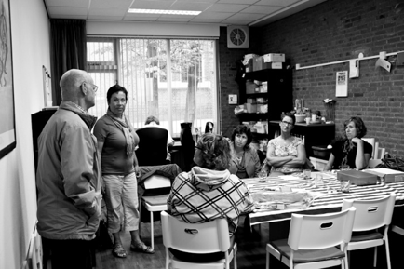
BUURTZORG 2007 - NOW
TEAMS
NURSES
50 - 100 new nurses a month
80.000+ patients a year

Slide 5
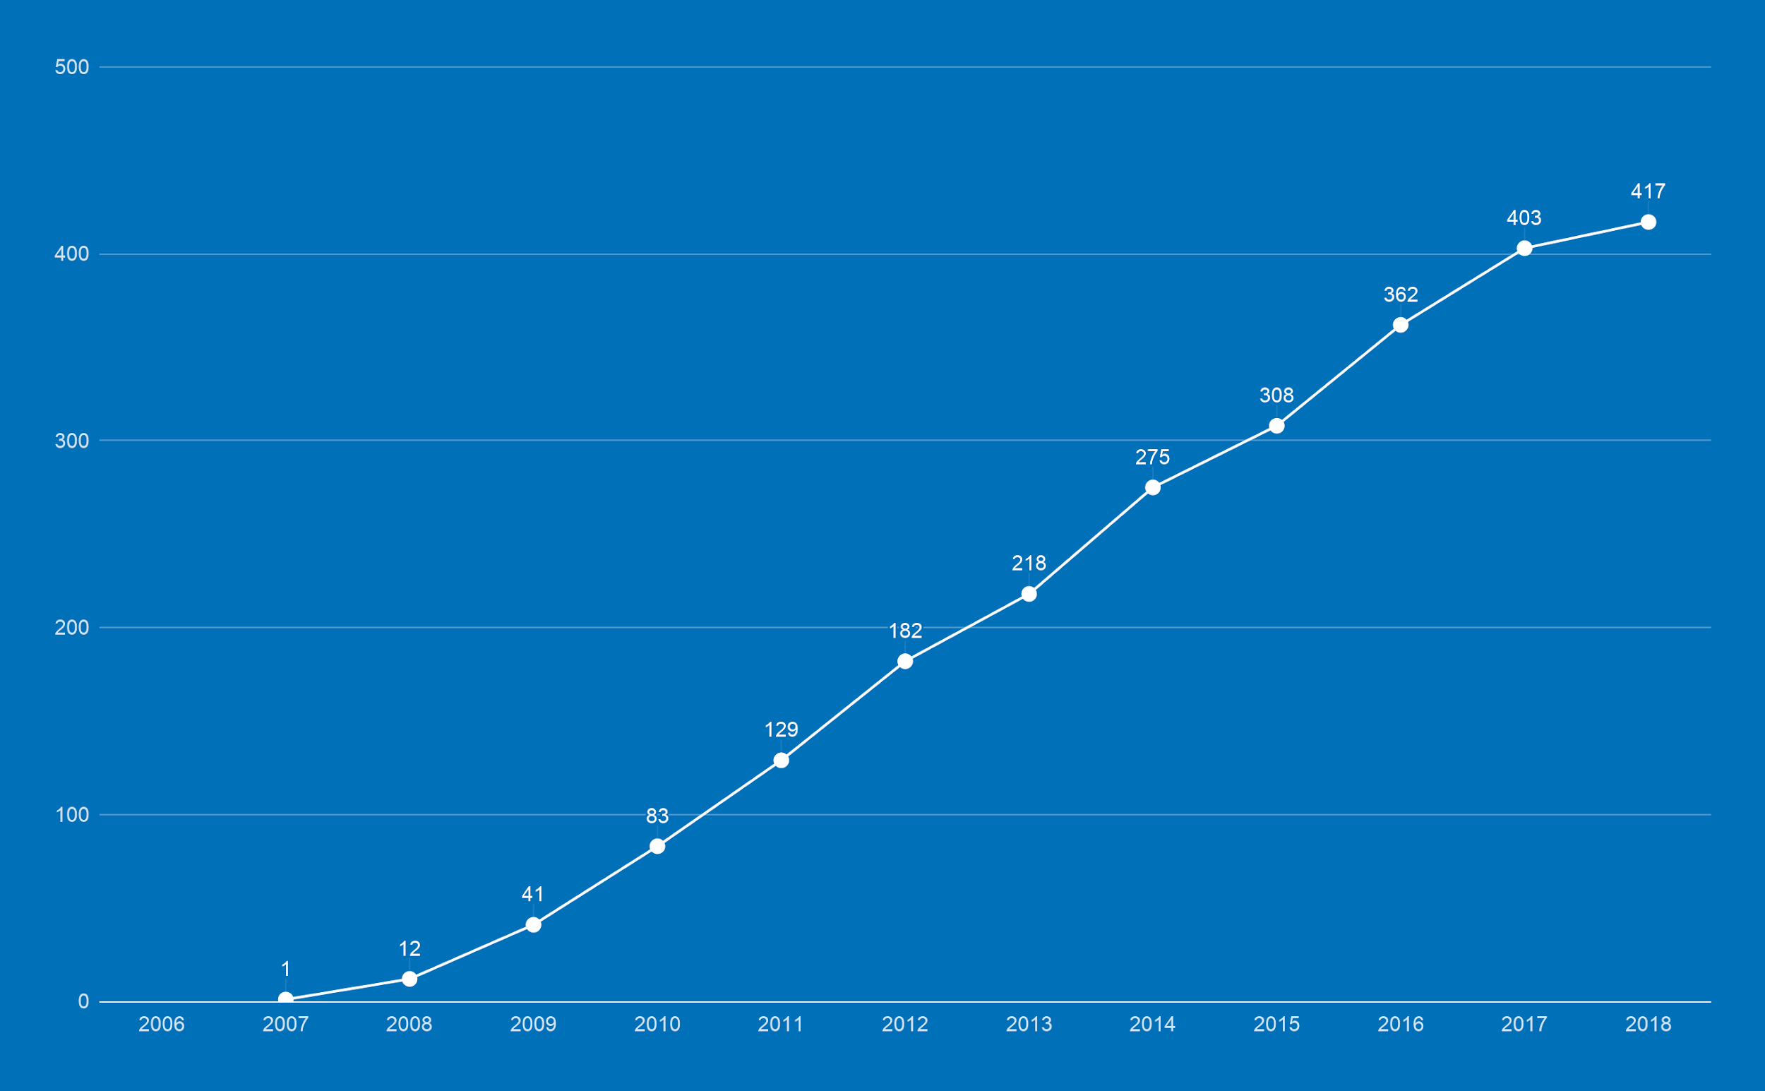
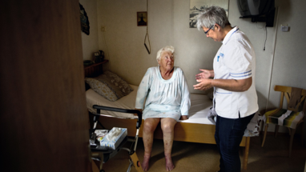
TURNOVER GROWTH
turnover in millions

Slide 6
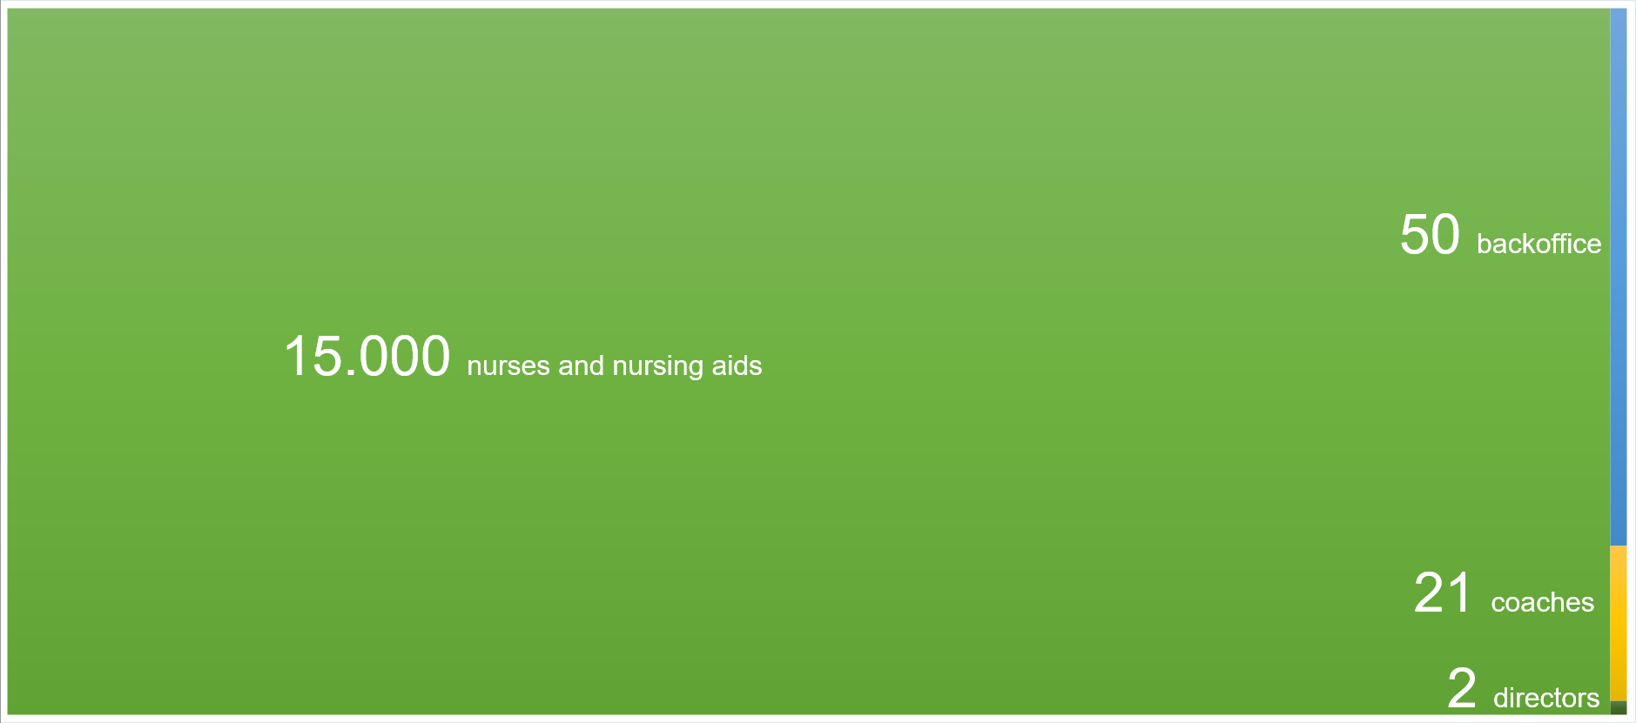
EMPLOYEES

Slide 7
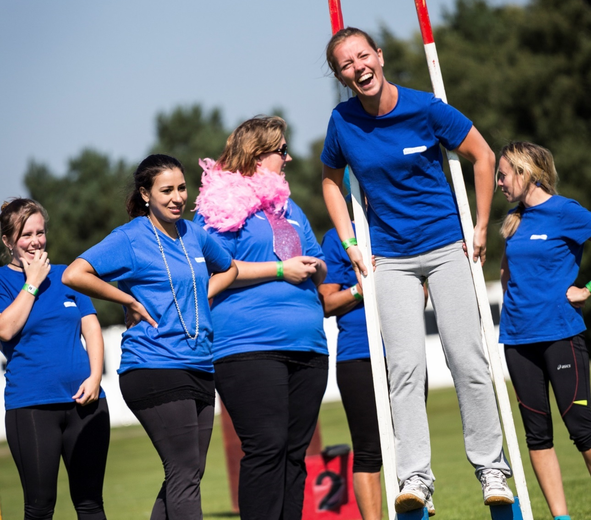
AND MORE...
Patient satisfaction: 9
Employee satisfaction: 9
5 times best employer of the year
overhead 8%
1200 new colleagues a year

Slide 8
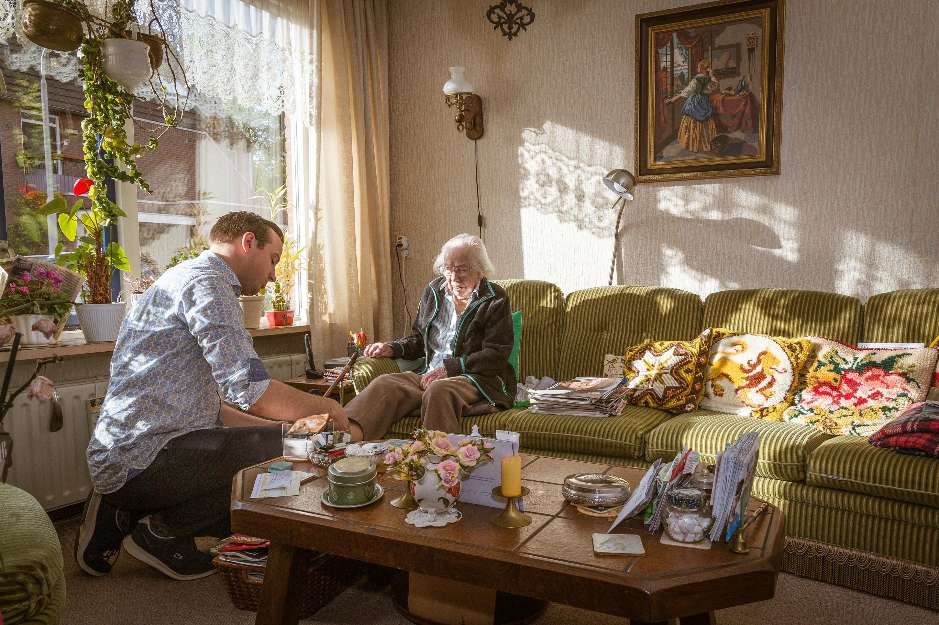
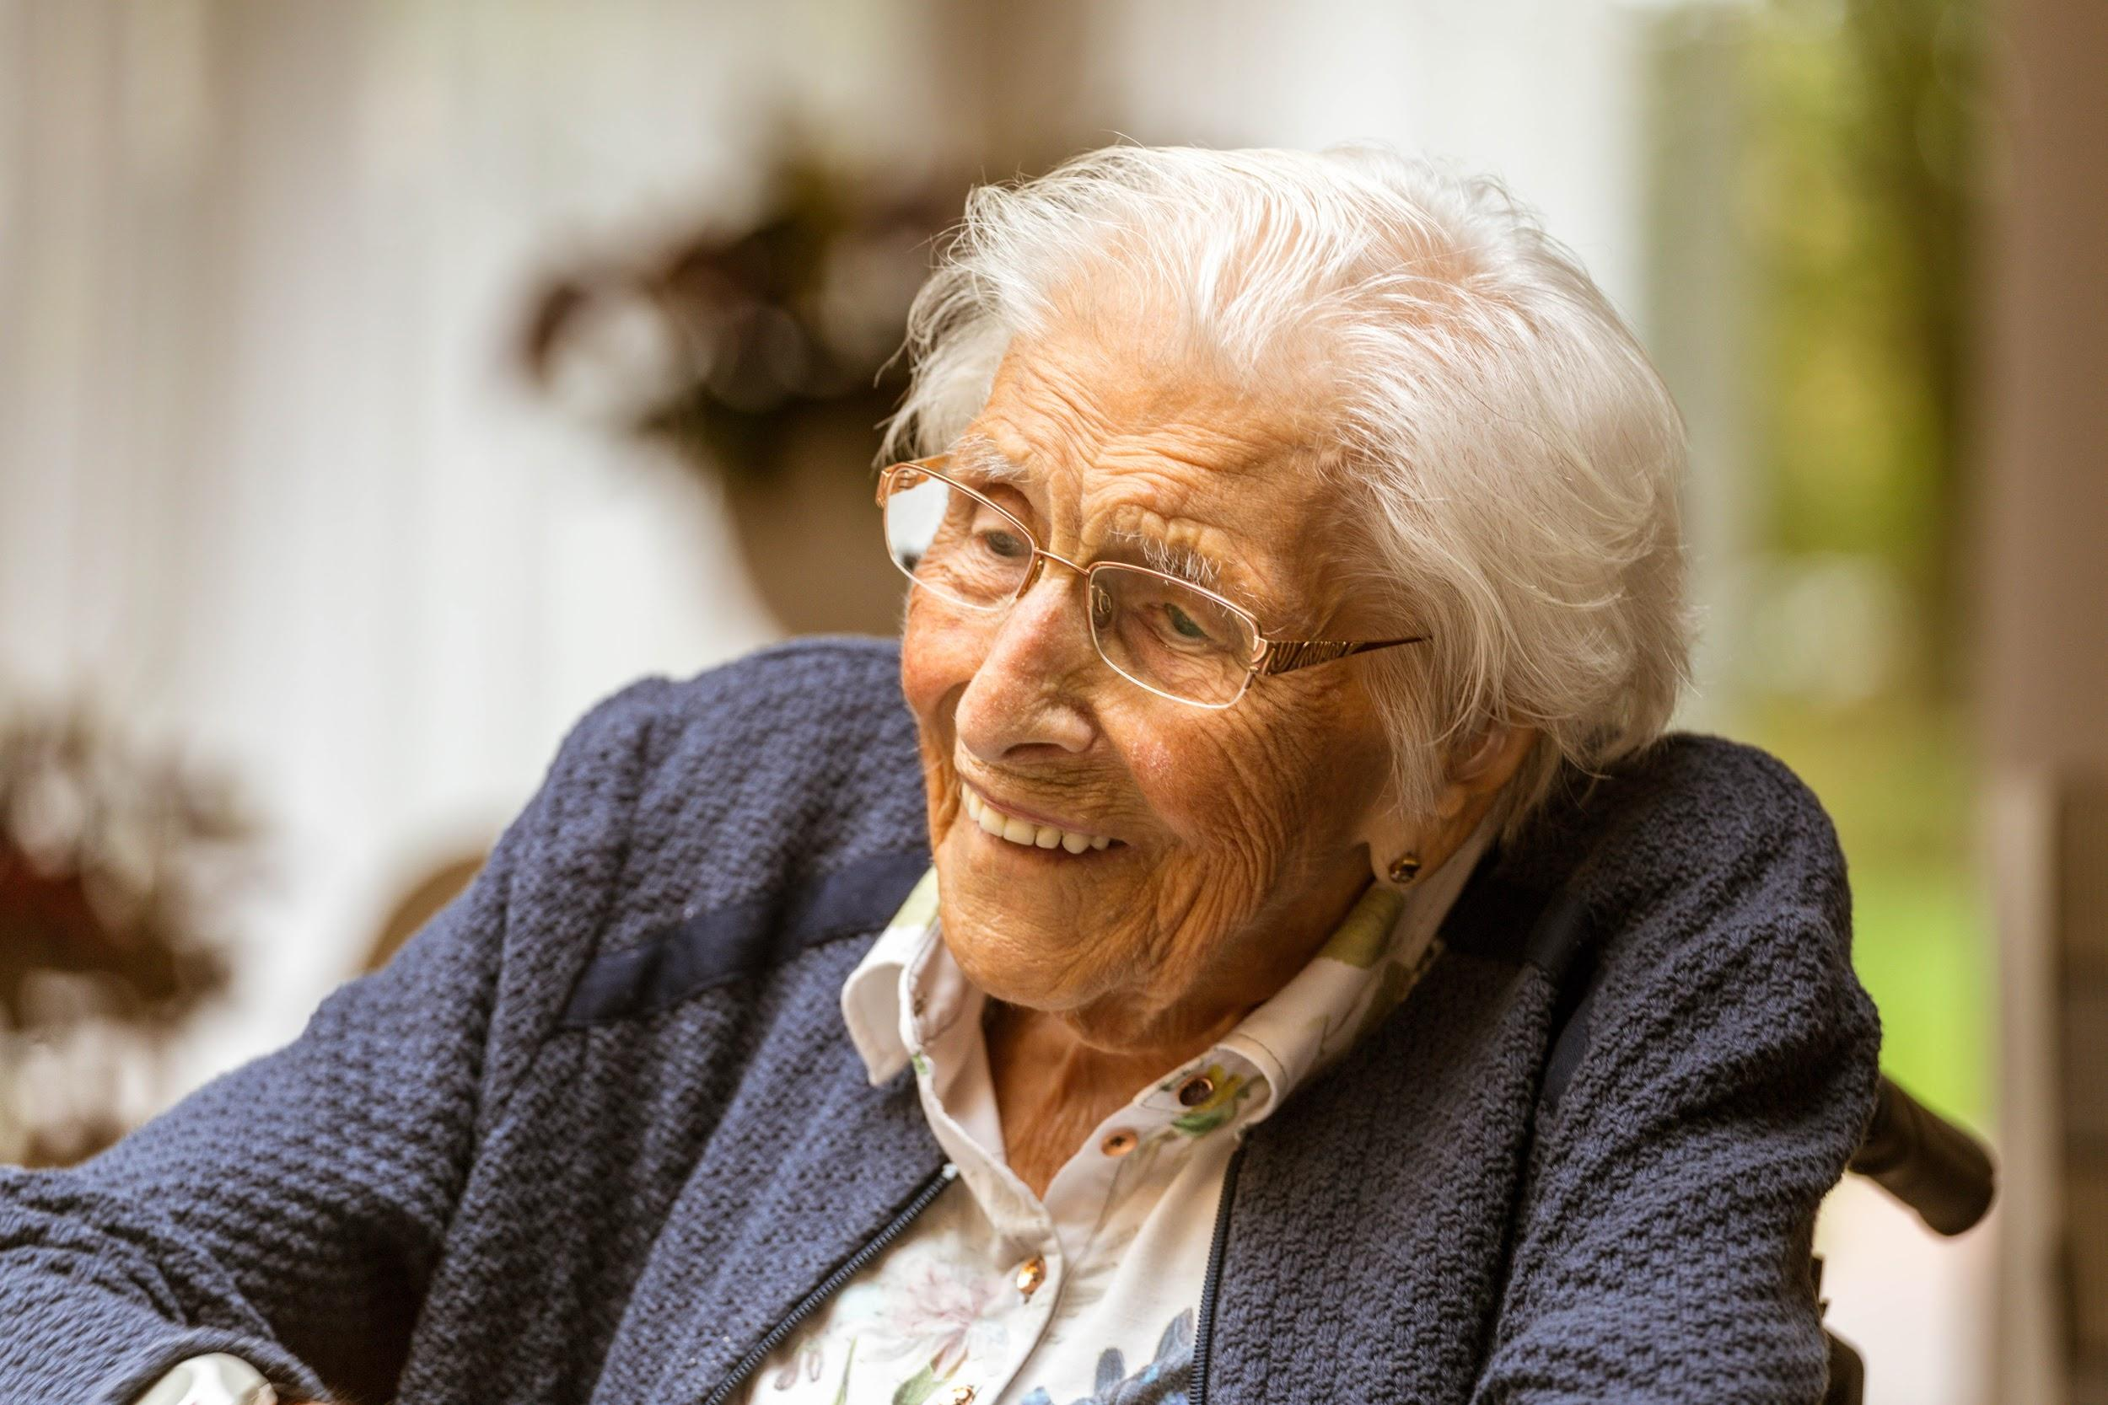
ONION MODEL
formal networks
CLIËNT
buurtzorgteam
informal networks
self management client
inside out | empowering and adaptive | network creating | supporting | additional | replacement

Slide 9
(SELF)ORGANIZATION
Optimal autonomy and no hierarchy: TRUST
Reduction of complexity (also by means of use of ICT)
Generalists: taking care for all type of patients
70% registered nurses / 40% bachelor degree
Own education budget
Informal networks are much more important than formal organizational structures

Slide 10
BUURTZORGWEB
(BY )
community
shared values
instruments
view on quality of care, transparency
communication in the care chain
position in the care chain, relationship with other caregivers
production
grip on the business
relationship professional and client

Slide 11
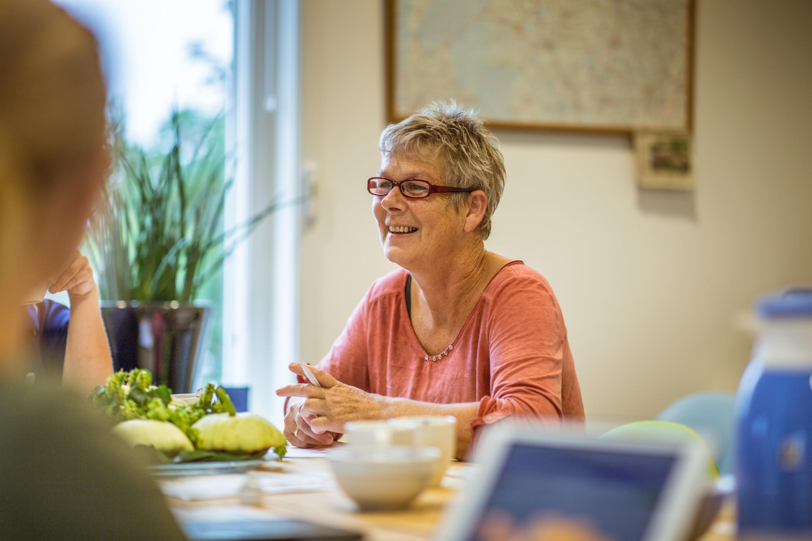
COST BENEFITS FOR THE CARE!
Cost savings up to 40 % (Buurtzorg model leads to more prevention, a shorter period of care and less spending on overhead)
More satisfied employees and clients
The government and all political parties are stimulating other care organizations to work like Buurtzorg
Other sectors are interested in the organization model

Slide 12
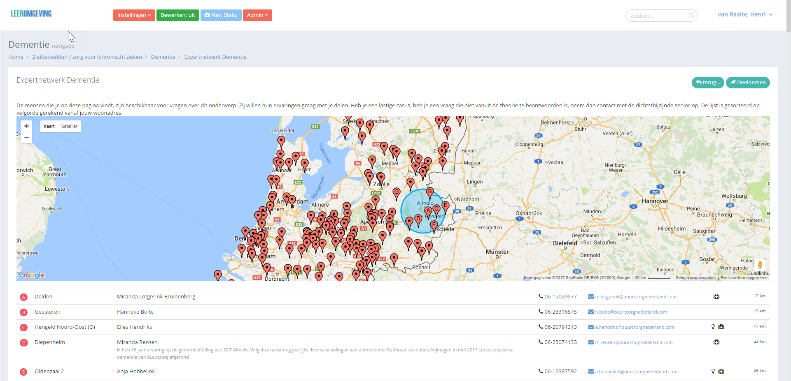
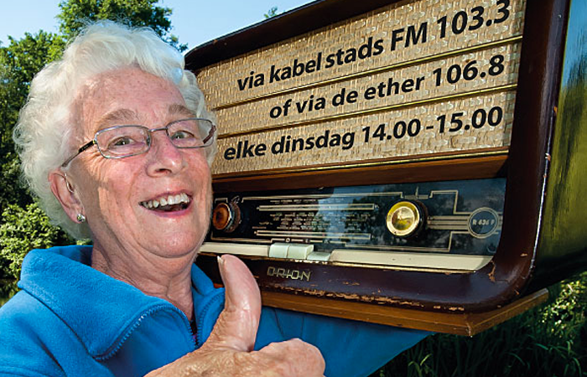
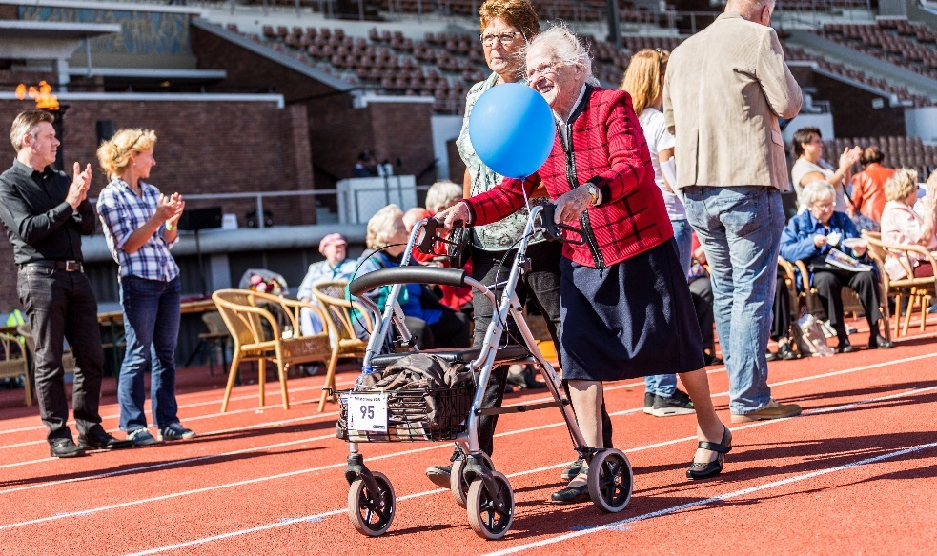
INNOVATIONS
Notes:
expertnetwerken, rollatorloop, radio steunkous, myshopeye, machine learning

Slide 13
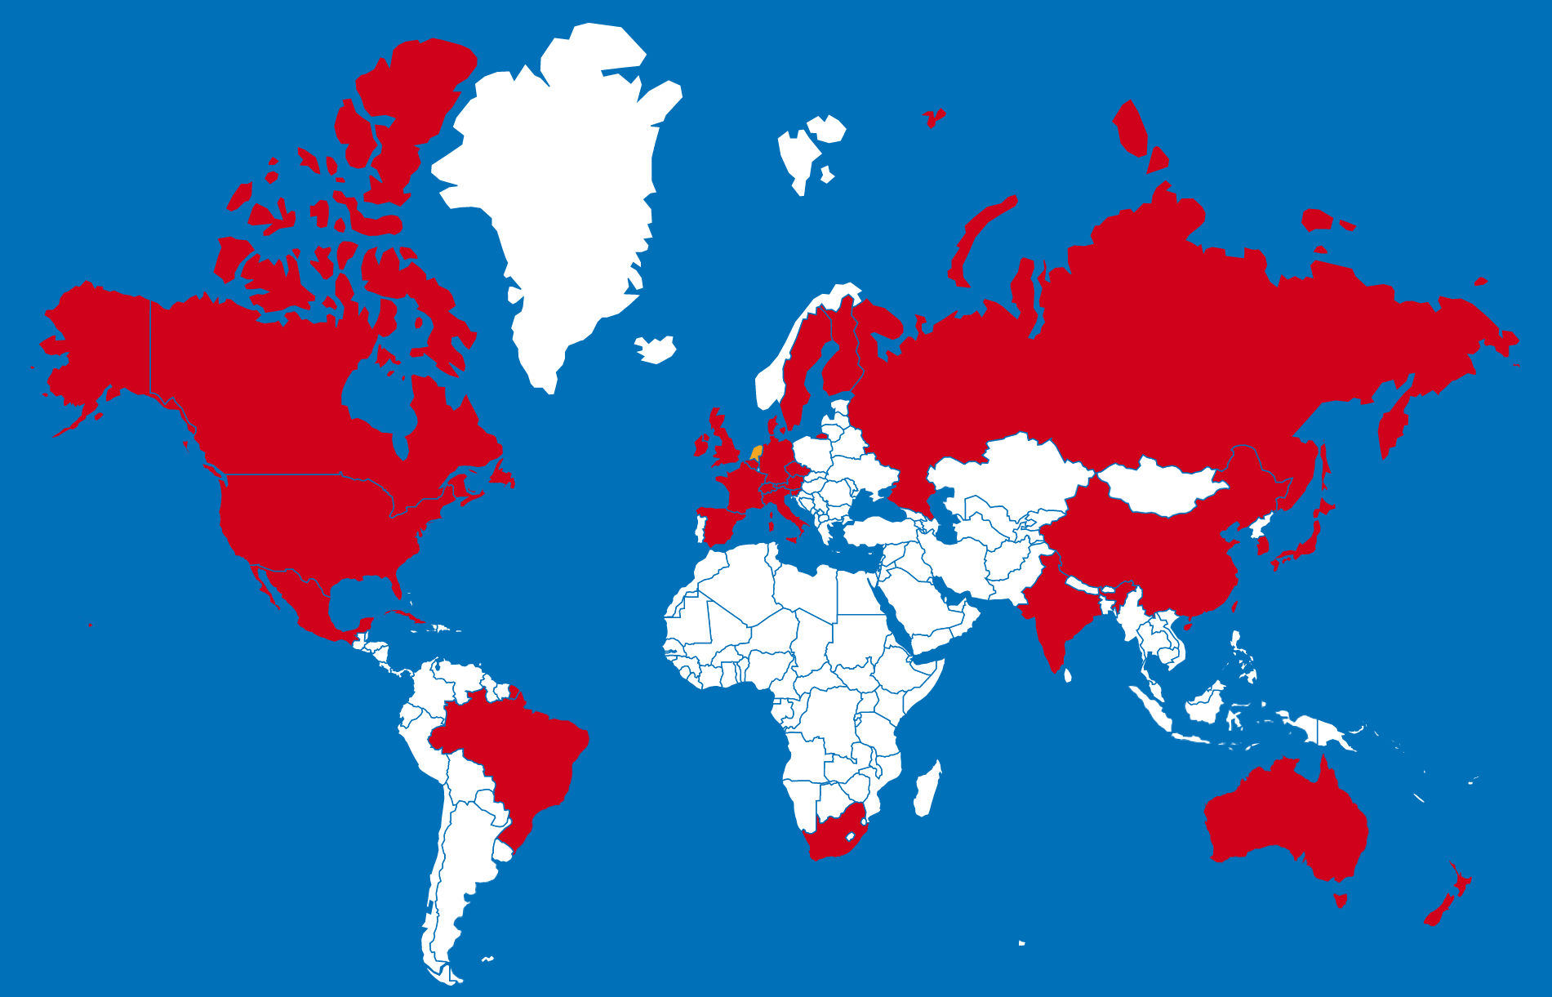
BUURTZORG INTERNATIONAL
Notes:
bron: picktochart.com

Slide 14
OFTEN HEARD...
Our people aren’t suited for self organizing, we’ve got the wrong ones…
We want best of both worlds.
Easy job. Just fire the managers and tell the teams they are in charge now.
It can be done without restructuring the back office.
It won’t work, it’s just a hype.
Notes:
We want best of both worlds. (Let’s manage self organisation)
You can’t manage the new direction.
You can only serve, guide and cut complexity.
Easy job. Just fire the managers and tell the teams they are in charge now.
You’ve got to work hard if your culture isn’t social. And you can’t schedule a culture change…
Most difficult part is restructuring the ’backoffice’ (PR, HRM, FM, etc...)
It’s not anarchy, you need a clear framework
Think of a Proof of Concept with a Minimal Viable Back office
It can be done without restructuring the back office.
Not true! Cutting complexity, redesigning processes and delete the right protocols and procedures is hard work!
It won’t work, it’s just a hype
We’ll see...
Avoid too much theory.

