Slide 1
Cities as social ecologies: breaking the public policy impasse
Martin Ferguson – Director of Policy & Research, Socitm (UK)
11th Global Peter Drucker Forum - November 22, 2019

Slide 2
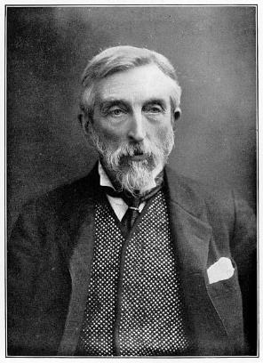
Notes:
Early example of social ecology in action.
Charles James Booth (30 March 1840 – 23 November 1916) - an English social researcher and reformer known for his innovative work in surveying and documenting working-class life in London at the end of the 19th century.

Slide 3
Public policy impasse
Perma-austerity
Centralisation of public policy-making
Top-down control
Increasing needs and demands
Dominance of narrow, sectional interests
Breakdown of trust
Persistence of deficits

Slide 4
Resurgence of ‘social ecology’ – Manchester and East London
Notes:
Cities are perfect ecosystems to produce innovation in services?
Take a brief look at two cities in the UK.
Resurgence of social ecology – can it help us break the public policy impasse and shape a better future?

Slide 5
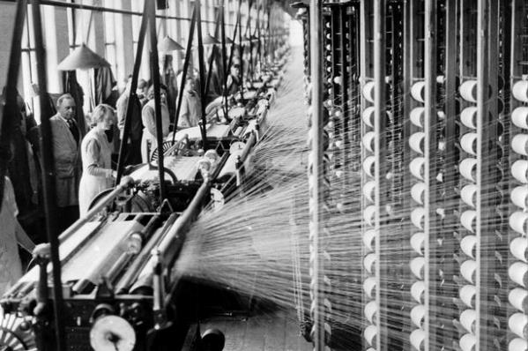
Context
Post-industrial ‘landscapes’
Notes:
Post-industrial urban environments
Manchester – Birthplace of Ind Rev, Peterloo Massacre 1819 (class struggle), Coop Movement:
2.8 million residents 127,700 hectares 10 local authorities (+1 CA) 10 local health bodies 1 Police Force 1 Fire and Rescue Service
Barking & Dagenham - Docks, Ford, changing demographics – just 15kms from the richest square mile in the world – City of London, realisation that Gov was not going to help
Literally post-Fordist!
Stable, semi-skilled, mainly (white) male jobs have disappeared
Over the past two decades seismic demographic change. In 2001, 89% of our population was white British; by 2011 this was less than half.
Some neighbourhoods where fewer than 9% of people associated with an address in 2011 were still living there in 2018.
B&D has the youngest population in the UK.

Slide 6
Deficits

Slide 7
Deficits
p
Notes:
We, in the collective sense (over 3,000 citizens contributed their thoughts), made a commitment to leaving ‘no-one behind’.
We needed a strategy we could measure. However, strategy cannot simply be guesswork, nor is it a function of professional prowess. We needed three things: to know, to focus, and to tell if what we are doing is working.
That does not just apply to us in the council. It applies to our partners, the third sector and civil society.
We are launching our own energy company to provide better tariffs for local people. But there is a difference this time. We know exactly where fuel poverty exists the most in our borough so we can target our intervention in the right place.
We have launched Community Solutions, our integrated people-based service focused on helping our residents get the best out of life.

Slide 8
Leadership and Governance
Notes:
Collaborative, servant leadership
Place-based
Outcomes focused
Devolved
Understanding the deficits
New institutions – GMCA, B&D Be First Growth, Regeneration and Development Company; Commission on Domestic Abuse
Generating solutions organically

Slide 9
Leadership and Governance
Company wholly owned by LB of Barking & Dagenham:
Business acumen of the private sector
Ethos of the public sector
Vitality of the voluntary sector
attracting developers and investors
plan to provide 50,000 high quality new homes and 20,000 new jobs within the next 20 years
Notes:
Collaborative, servant leadership
Place-based
Outcomes focused
Devolved
Understanding the deficits
New institutions – GMCA, B&D Be First Growth, Regeneration and Development Company; Commission on Domestic Abuse
Generating solutions organically

Slide 10
Skills and capabilities
Notes:
Co-creating ecosystems and solutions
Enabling networks
Harnessing mindset and skillset
‘Agile’ working
Embedding design
Digital skills for all
Leveraging data

Slide 11
Data and tools
Notes:
Social Progess Index
More than a century after Booth’s work, still in East London.
The first ward-level index that focuses on the social progress of our residents.
Aim is to improve our community through intelligent, evidence-based action.
Today - availability of data and tech - metrics, including health, wellbeing, noise and air pollution, rates of exercise and obesity, recycling and domestic violence.
On a street-by-street, house-by-house basis.
The Social Progress Index has told us where we need to locate our assets, our services and our people, based on the needs of our citizens, rather than the historic accident of land ownership and building leases.
Able to measure how the needs of our citizens are changing over time.
Measuring outcomes, not inputs or outputs, provides the basis for collaboration and participation. These metrics tie us all together, hold us accountable and it is easy to see where we need to improve. Importantly, it is accessible by everyone.

Slide 12
Data and tools
Notes:
Co-creating solutions as a by product of what people are already doing – mapping behaviours in their immediate environment

Slide 13
Cities as social ecologies: breaking the public policy impasse
Concern for people and their wellbeing
Place-based
Whole system
Tackling the deficits
Drilling into the data
Co-creating
Enabling
Notes:
Balancing enabling:
- Indirect oversight
- Connect
- Coordinate
- Encourage
- Provide access to funding
- Promote
- Champion
with delivering:
- Direct oversight
- Specific projects or programmes
- Formal governance routes
- Direct funding and resourcing
Last year - Charles Handy at this Forum – talked about the gulf between the ownership and the management of private companies and corporations - exhorted us to take care that our humanity is not swamped by the digital revolution.
So, my question is: Does social ecology offer us the opportunity to break the public policy impasse handed to us by the industrial age?
Can we replace it with a new paradigm where we harness data and technology in ways that are ethical and that keep human values intact in the way that our communities are led and governed?

