Slide 1
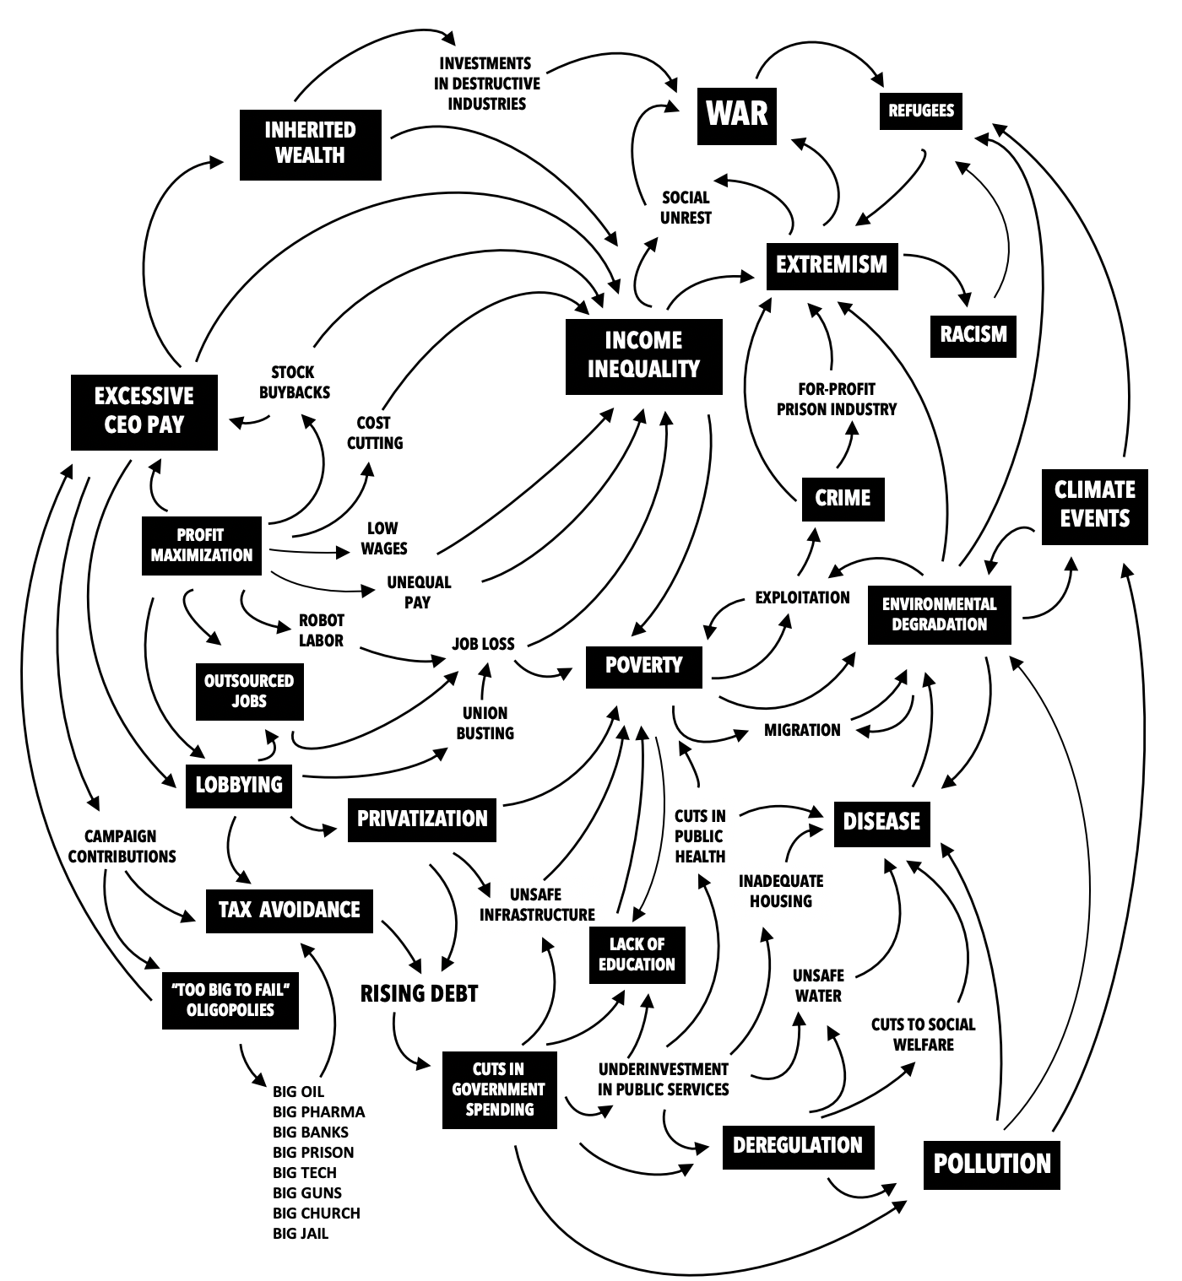
©2019 Christian Sarkar and Philip Kotler
THE ECOSYSTEM of WICKED PROBLEMS

Slide 2
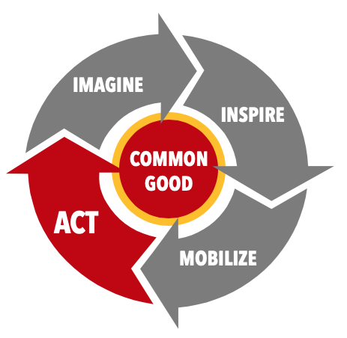
ARCHITECTING A PLATFORM for THE COMMON GOOD
COMMUNITY STAKEHOLDERS
RESIDENTS
ELDERS / LEADERS
LOCAL BUSINESS
LOCAL GOVERNMENT
COMMON GOOD PROJECTS
PLATFORM of PURPOSE
A
B
PUBLIC VALUE
CREATION
PLATFORM PARTNER ECOSYSTEM
C
D
DELIVERY
E
GLOBAL PARTNER ECOSYSTEM
LESSONS
COMMON GOOD: “what is shared and beneficial for all or most members of a given community, or alternatively, what is achieved by citizenship, collective action, and active participation in the realm of politics and public service.”
© 2019 Christian Sarkar and Philip Kotler.

Slide 3
FUTURE SUCCESS
VISION
HOPE
WHAT is our DESTINY?
trajectory of hope
What must be done to get there?
THE PRESENT
WHO or WHAT is the ENEMY?
trajectory of fear
What are the biggest threats?
FEAR
STRUCTURE of a CULTURAL NARRATIVE
FUTURE FAILURE
©2019 Christian Sarkar and Philip Kotler

