Slide 1
Trust in the digital ecosystem era
The 11th Global
Peter Drucker Forum
A New Era for Strategy and Strategy Making
November 21, 2019
Yoshikuni Takashige
Fujitsu Limited

Slide 2
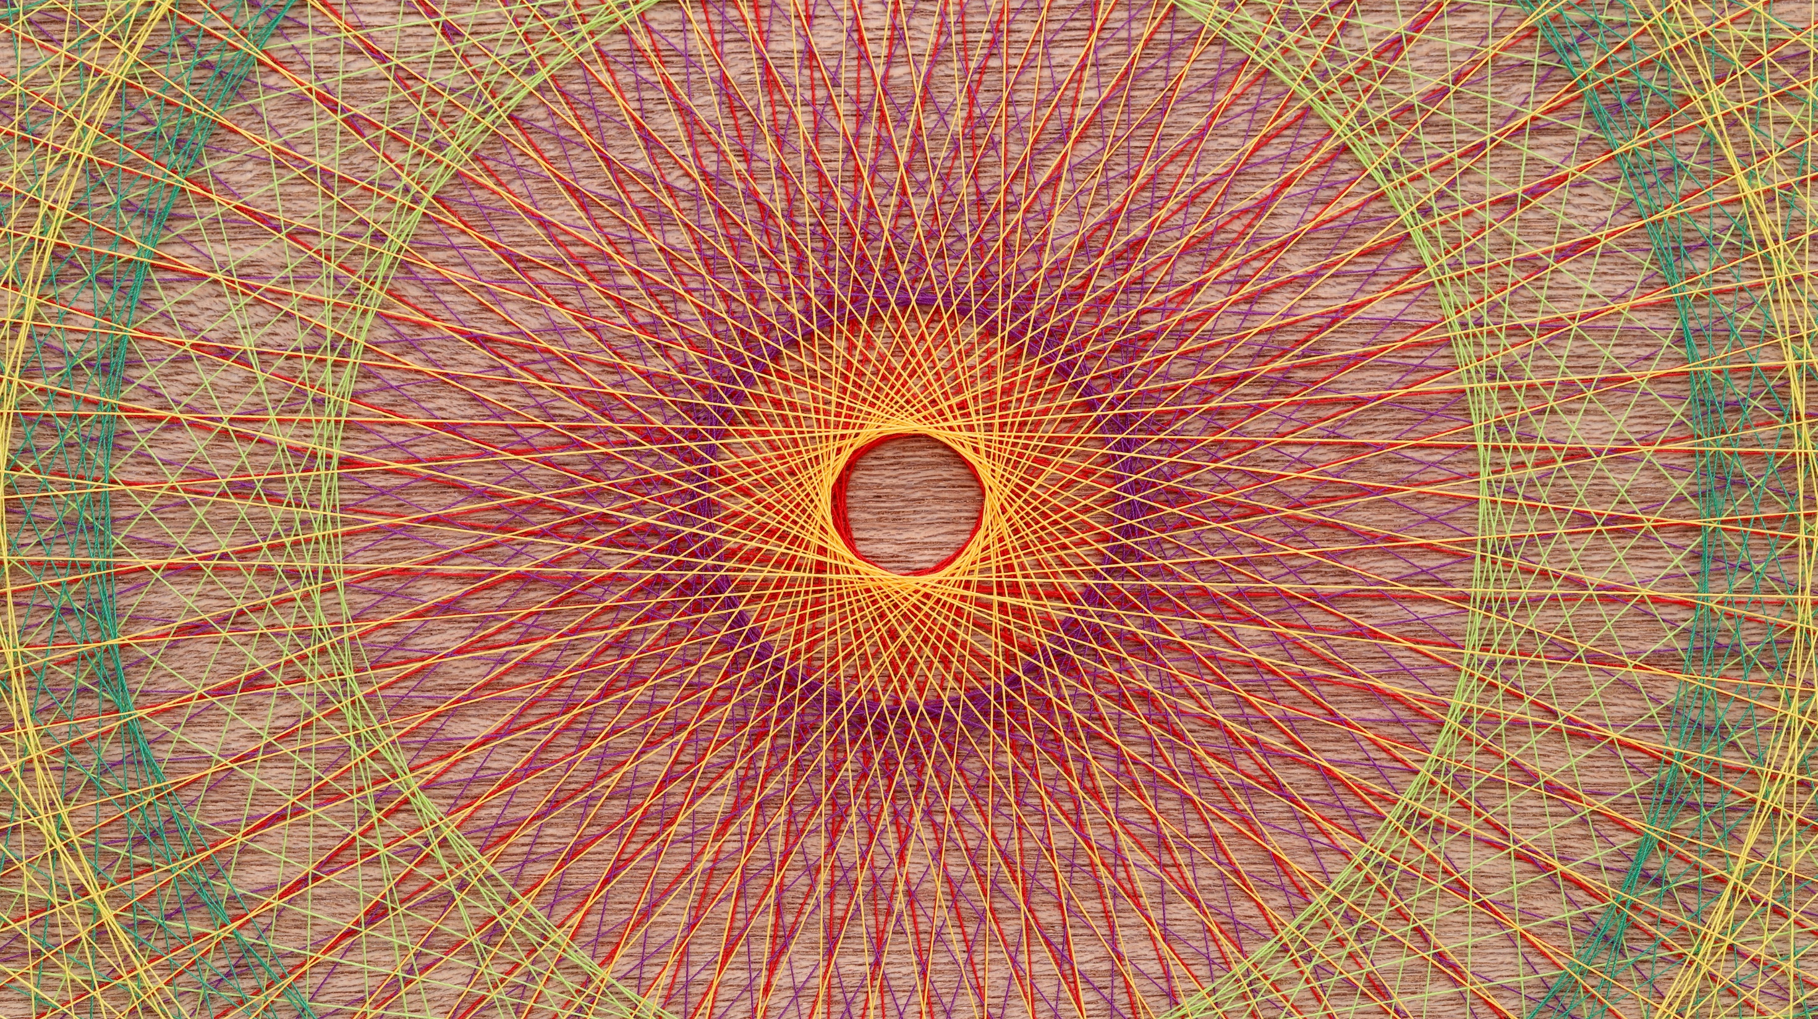
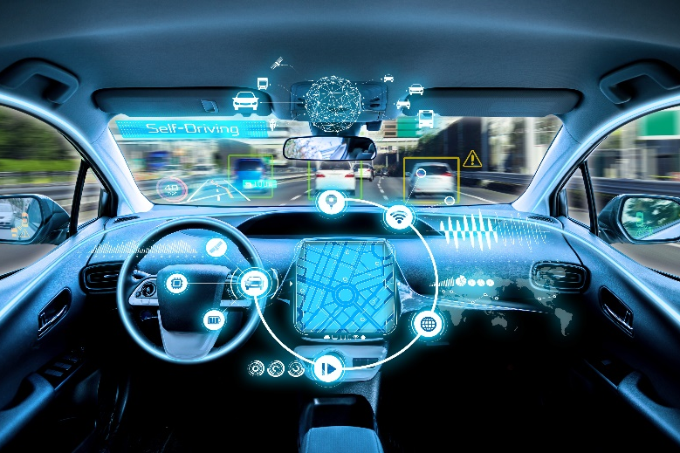
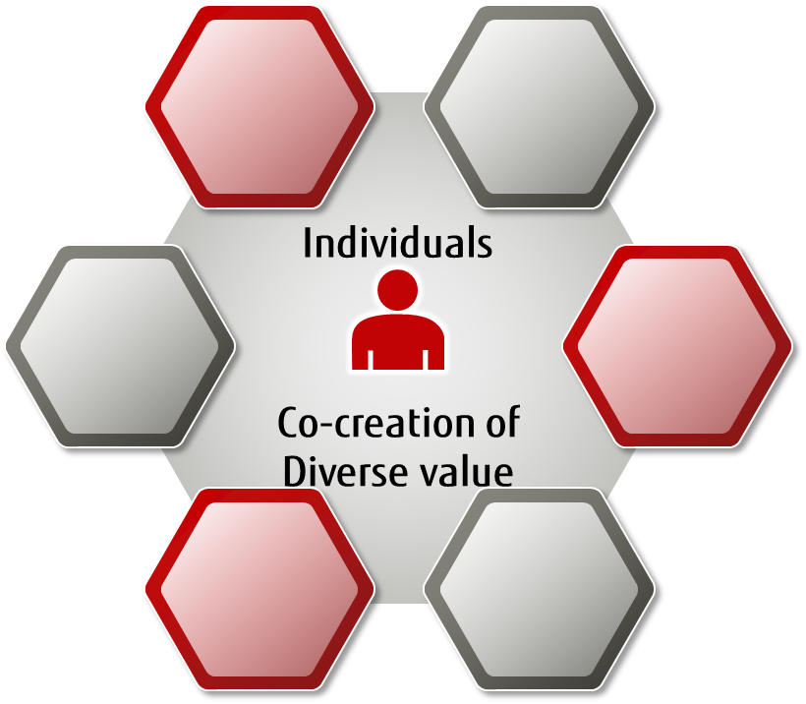
Digital is driving a Massively Connected, Autonomous and Distributed World
Web of Everything
Autonomous Things
Distributed Ecosystems

Slide 3
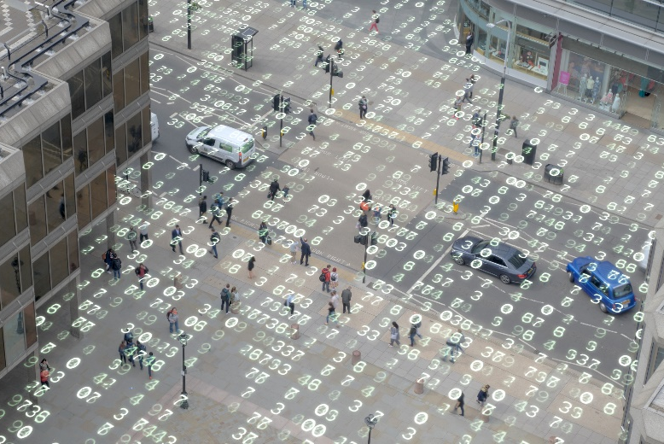
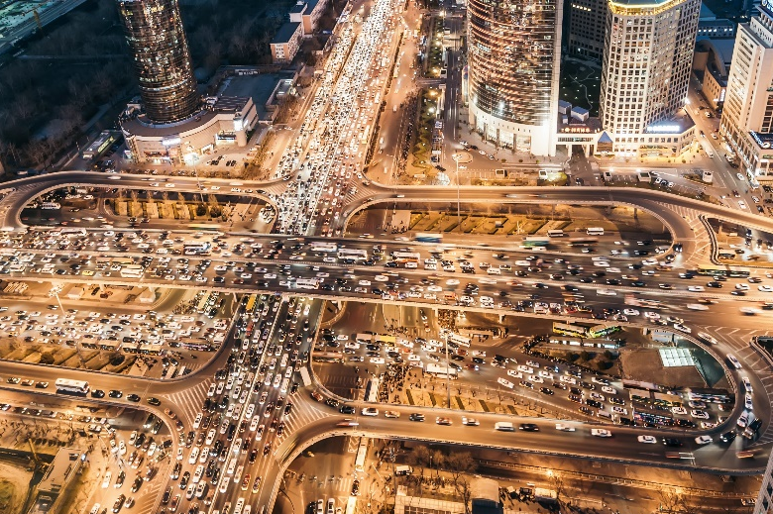
A Chaotic World
Data and Privacy
Judgement of AI
Complexity

Slide 4
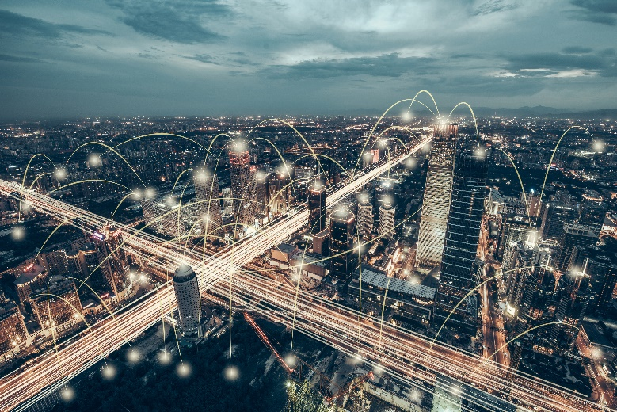
Keys to Trusted Ecosystems
Purpose-driven
Human Centric
Digital Trust
Copyright 2019 FUJITSU LIMITED

